Slide 1
EM Algorithms for Learning Local Dynamics Models in a Bayesian Framework
Samuel Otto

Slide 2
Outline
Motivation
Problem Setup
Maximum Likelihood and the EM Algorithm
Explicit Solutions for Maximization Step
Weighted Regression
Weighted Gaussian Mixture
Categorical “Multinoulli” Distribution
Reconstructing the Estimates
Testing on a Chaotic Poincare Map
K-Means and Generalized K-Means as efficient EM variants
Test on Chaotic Poincare Map
Extending to Nonlinear Local Dynamics using Kernels
Test Variants on Chaotic Poincare Map
Extending to Non-Gaussian Density Estimation using Kernels
Future Work

Slide 3
Motivation
Model complex, possibly chaotic dynamics using data.
Effect of control perturbations
Short-term prediction
Generative modeling: plausible dynamics sharing statistical properties
Analyze dynamics locally and globally
Local spectral analysis
Identify global structures like orbits, tori, and attractors
Understand the distribution of data points in phase space
Structure of data distribution in phase space
Identify regions of interest

Slide 4
Three Main Approaches
If dynamics vary nonlinearly over phase space, we have three main approaches for modeling:
Use a single model with many nonlinear terms giving it enough representational capacity to capture dynamics everywhere.
EDMD: Use large number of nonlinear observables
Kernel Method: Kernel matrix grows with the square of the number of data points
Piece together many local models with fewer nonlinear terms in each
Models with fewer parameters can be updated and evaluated quickly
Representational power is increased simply by adding more models
Fully non-parametric representation using locally-weighted regression (Not practical)

Slide 5
Local Modeling Approach
Model distribution of data in phase space using mixture of Gaussians
Universal approximator for continuous distributions
To each Gaussian, we associate a model of the dynamics in that neighborhood
Introduce a latent variable indicating which model describes the dynamics at a given point.
Allows for new points to be classified according to maximum likelihood among the models
Finds the model most likely to capture dynamics at the new point
Must learn the mixture of Gaussians and corresponding local dynamics together
Data clustering alone does not reflect the number of local models needed to capture dynamics in a region

Slide 6
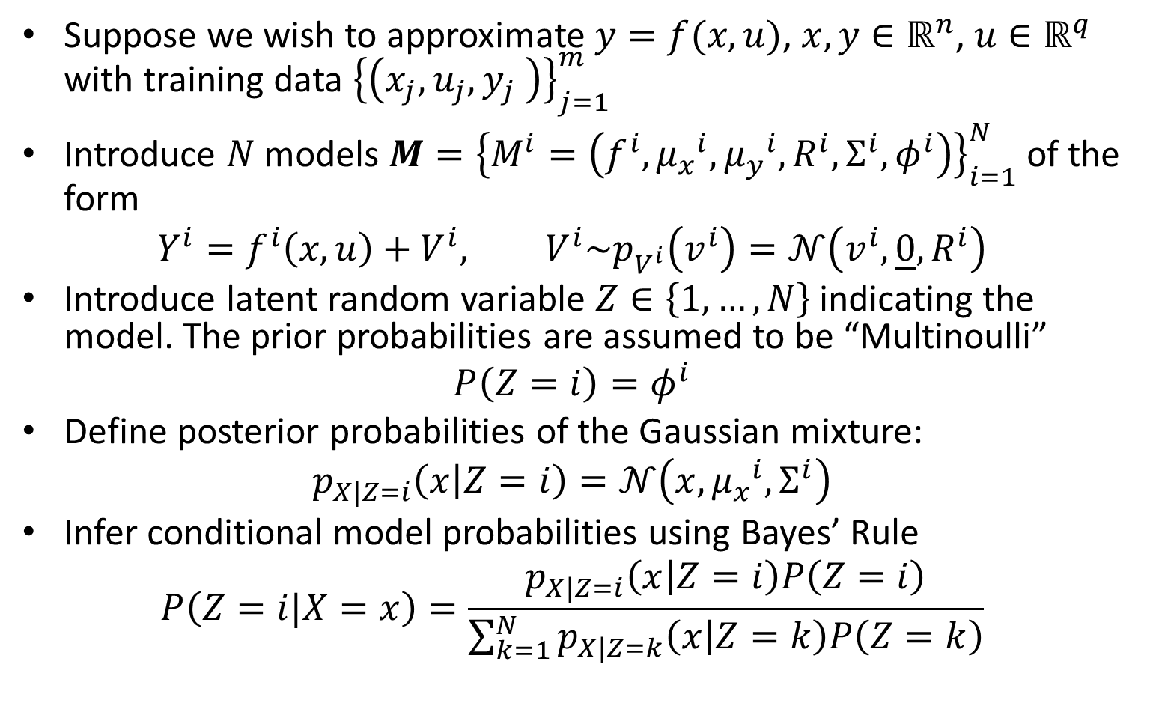
Problem Setup
Suppose we wish to approximate $y=f(x,u)$, $x,y∈ℝ^{n}$, $u∈ℝ^{q}$ with training data ${\left\{\left(x_{j},u_{j},y_{j} \right)\right\}}_{j=1}^{m}$
Introduce $N$ models $M={\left\{M^{i}=\left(f^{i},{μ_{x}^{}}^{i},{μ_{y}^{}}^{i},R^{i},Σ^{i},φ^{i}\right)\right\}}_{i=1}^{N}$ of the form
$$Y^{i}=f^{i}\left(x,u\right)+V^{i}, V^{i}\sim p_{V^{i}}\left(v^{i}\right)=𝒩\left(v^{i},\underline{0},R^{i}\right)$$
Introduce latent random variable $Z∈\left\{1,…,N\right\}$ indicating the model. The prior probabilities are assumed to be “Multinoulli”
$$P\left(Z=i\right)=φ^{i}$$
Define posterior probabilities of the Gaussian mixture:
$$p_{X|Z=i}\left(x | Z=i\right)=𝒩\left(x,{μ_{x}^{}}^{i},Σ^{i}\right)$$
Infer conditional model probabilities using Bayes’ Rule
$$P\left(Z=i|X=x\right)=\frac{p_{X|Z=i}\left(x | Z=i\right)P\left(Z=i\right)}{\sum_{k=1}^{N}{p_{X|Z=k}\left(x | Z=k\right)P\left(Z=k\right)}}$$

Slide 7
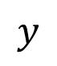
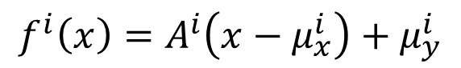
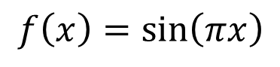
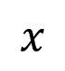
Problem Setup
$$f\left(x\right)=\sin\left(πx\right)$$
$$f^{i}\left(x\right)=A^{i}\left(x−μ_{x}^{i}\right)+μ_{y}^{i}$$
$$y$$
$$x$$

Slide 8
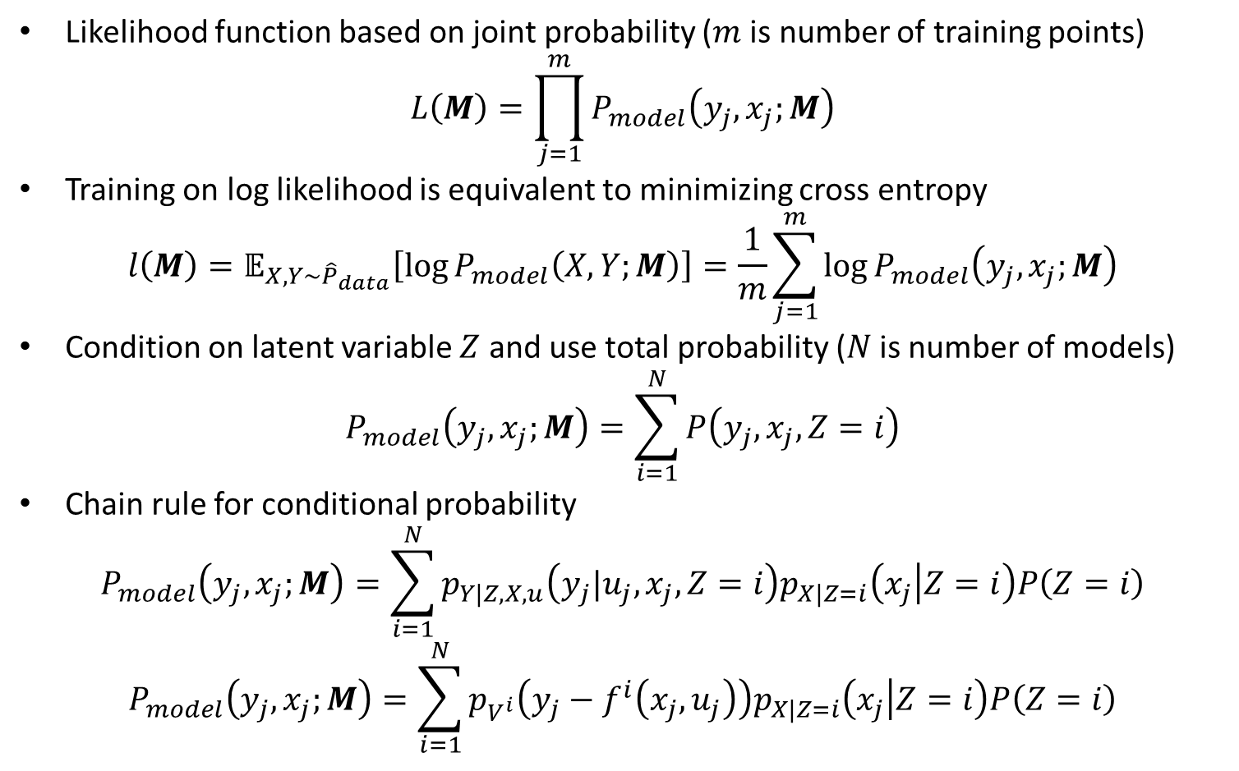
Maximum Likelihood Estimation
Likelihood function based on joint probability ($m$ is number of training points)
$$L\left(M\right)=\prod_{j=1}^{m}{P_{model}\left(y_{j},x_{j};M\right)}$$
Training on log likelihood is equivalent to minimizing cross entropy
$$l\left(M\right)=𝔼_{X,Y\sim {\hat{P}}_{data}}\left[\log{P_{model}\left(X,Y;M\right)}\right]=\frac{1}{m}\sum_{j=1}^{m}{\log{P_{model}\left(y_{j},x_{j};M\right)}}$$
Condition on latent variable $Z$ and use total probability ($N$ is number of models)
$$P_{model}\left(y_{j},x_{j};M\right)=\sum_{i=1}^{N}{P\left(y_{j},x_{j},Z=i\right)}$$
Chain rule for conditional probability
$$P_{model}\left(y_{j},x_{j};M\right)=\sum_{i=1}^{N}{p_{Y|Z,X,u}\left(y_{j}|u_{j},x_{j},Z=i\right)p_{X|Z=i}\left(x_{j} | Z=i\right)P\left(Z=i\right)}$$
$$P_{model}\left(y_{j},x_{j};M\right)=\sum_{i=1}^{N}{p_{V^{i}}\left(y_{j}−f^{i}\left(x_{j},u_{j}\right)\right)p_{X|Z=i}\left(x_{j} | Z=i\right)P\left(Z=i\right)}$$

Slide 9
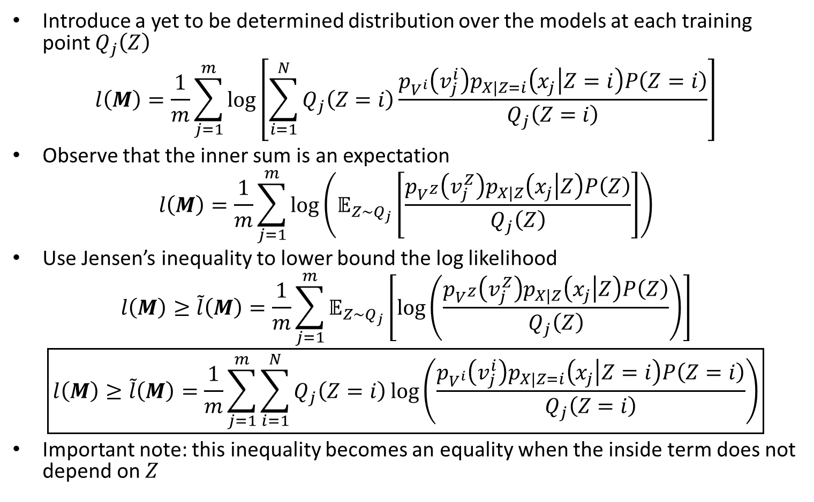
Maximum Likelihood Estimation
Introduce a yet to be determined distribution over the models at each training point $Q_{j}\left(Z\right)$
$$l\left(M\right)=\frac{1}{m}\sum_{j=1}^{m}{\log\left[\sum_{i=1}^{N}{Q_{j}\left(Z=i\right)\frac{p_{V^{i}}\left(v_{j}^{i}\right)p_{X|Z=i}\left(x_{j} | Z=i\right)P\left(Z=i\right)}{Q_{j}\left(Z=i\right)}}\right]}$$
Observe that the inner sum is an expectation
$$l\left(M\right)=\frac{1}{m}\sum_{j=1}^{m}{\log\left(𝔼_{Z\sim Q_{j}}\left[\frac{p_{V^{Z}}\left(v_{j}^{Z}\right)p_{X|Z}\left(x_{j} | Z\right)P\left(Z\right)}{Q_{j}\left(Z\right)}\right]\right)}$$
Use Jensen’s inequality to lower bound the log likelihood
$$l\left(M\right)≥\tilde{l}\left(M\right)=\frac{1}{m}\sum_{j=1}^{m}{𝔼_{Z\sim Q_{j}}\left[\log\left(\frac{p_{V^{Z}}\left(v_{j}^{Z}\right)p_{X|Z}\left(x_{j} | Z\right)P\left(Z\right)}{Q_{j}\left(Z\right)}\right)\right]}$$
$$\boxed{l\left(M\right)≥\tilde{l}\left(M\right)=\frac{1}{m}\sum_{j=1}^{m}{\sum_{i=1}^{N}{Q_{j}\left(Z=i\right)\log\left(\frac{p_{V^{i}}\left(v_{j}^{i}\right)p_{X|Z=i}\left(x_{j} | Z=i\right)P\left(Z=i\right)}{Q_{j}\left(Z=i\right)}\right)}}}$$
Important note: this inequality becomes an equality when the inside term does not depend on $Z$

Slide 10
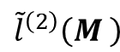
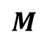
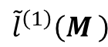
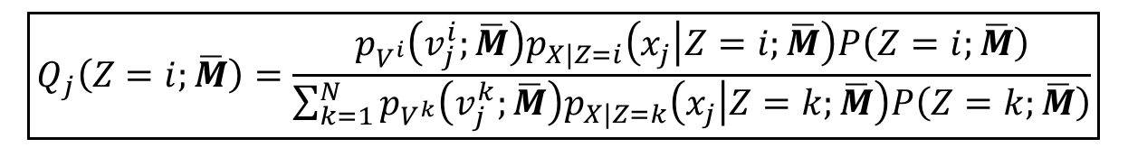
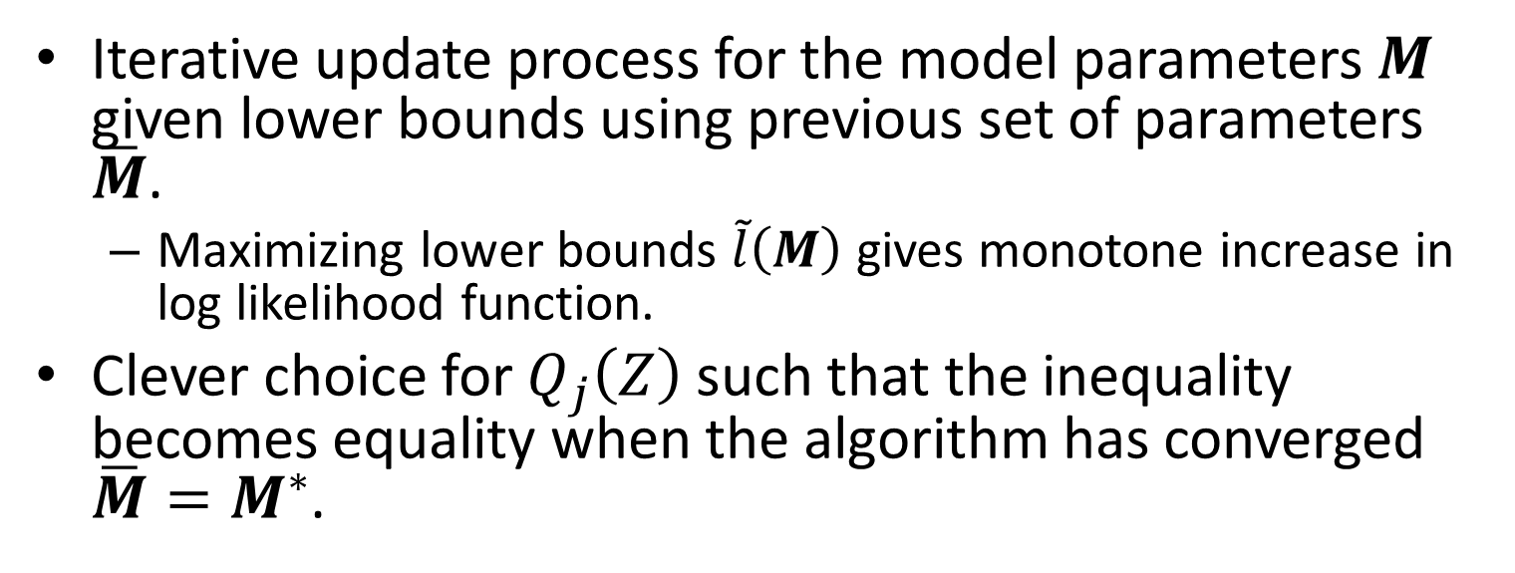
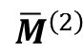
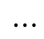
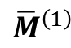
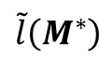
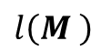
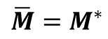
The EM Algorithm
Iterative update process for the model parameters $M$ given lower bounds using previous set of parameters $\overline{M}$.
Maximizing lower bounds $\tilde{l}\left(M\right)$ gives monotone increase in log likelihood function.
Clever choice for $Q_{j}\left(Z\right)$ such that the inequality becomes equality when the algorithm has converged $\overline{M}=M^{∗}$.
$$\boxed{Q_{j}\left(Z=i;\overline{M}\right)=\frac{p_{V^{i}}\left(v_{j}^{i};\overline{M}\right)p_{X|Z=i}\left(x_{j} | Z=i;\overline{M}\right)P\left(Z=i;\overline{M}\right)}{\sum_{k=1}^{N}{p_{V^{k}}\left(v_{j}^{k};\overline{M}\right)p_{X|Z=k}\left(x_{j} | Z=k;\overline{M}\right)P\left(Z=k;\overline{M}\right)}}}$$
$${\tilde{l}}^{\left(2\right)}\left(M \right)$$
$$\tilde{l}\left(M^{∗}\right)$$
$${\tilde{l}}^{\left(1\right)}\left(M \right)$$
$$l\left(M \right)$$
Log Likelihood
$$M$$
$${\overline{M}}^{\left(1\right)}$$
$${\overline{M}}^{\left(2\right)}$$
$$⋯$$
$$\overline{M}=M^{∗}$$

Slide 11
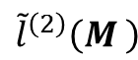
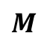
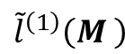
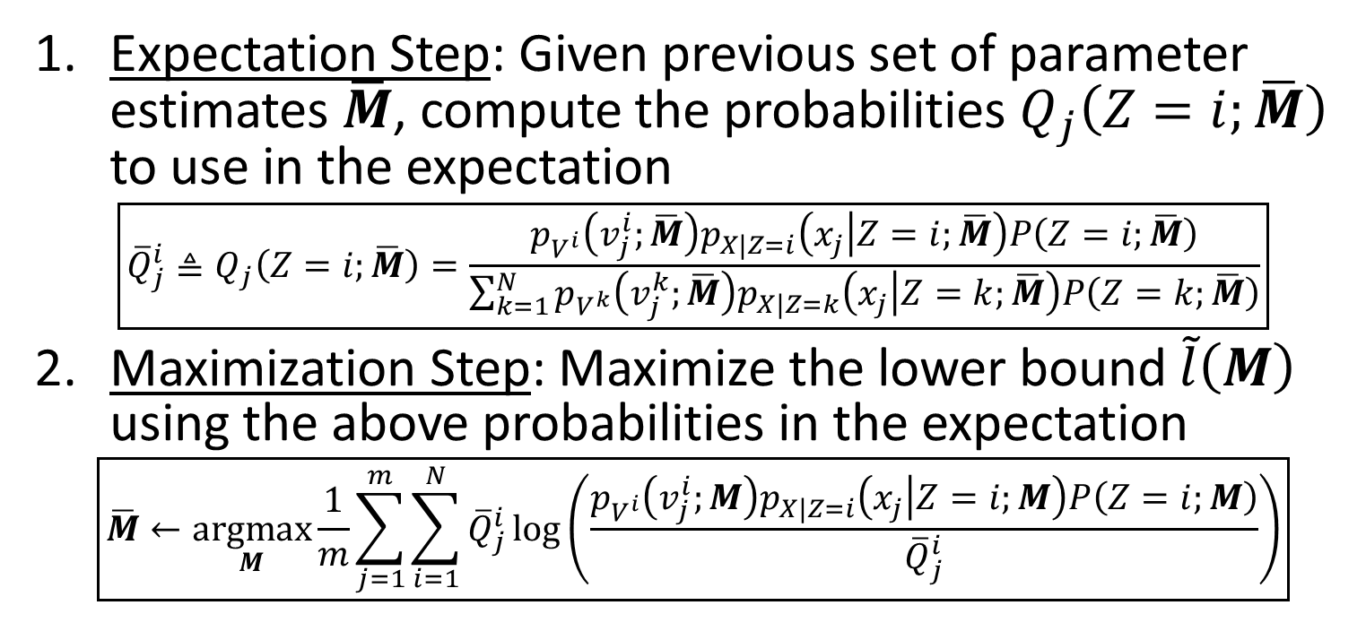
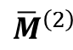
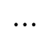
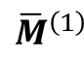
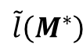
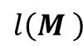
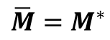
The EM Algorithm
Expectation Step: Given previous set of parameter estimates $\overline{M}$, compute the probabilities $Q_{j}\left(Z=i;\overline{M}\right)$ to use in the expectation
$$\boxed{{\overline{Q}}_{j}^{i}≜Q_{j}\left(Z=i;\overline{M}\right)=\frac{p_{V^{i}}\left(v_{j}^{i};\overline{M}\right)p_{X|Z=i}\left(x_{j} | Z=i;\overline{M}\right)P\left(Z=i;\overline{M}\right)}{\sum_{k=1}^{N}{p_{V^{k}}\left(v_{j}^{k};\overline{M}\right)p_{X|Z=k}\left(x_{j} | Z=k;\overline{M}\right)P\left(Z=k;\overline{M}\right)}}}$$
Maximization Step: Maximize the lower bound $\tilde{l}\left(M\right)$ using the above probabilities in the expectation
$$\boxed{\overline{M}←\underset{M}{argmax}{\frac{1}{m}\sum_{j=1}^{m}{\sum_{i=1}^{N}{{\overline{Q}}_{j}^{i}\log\left(\frac{p_{V^{i}}\left(v_{j}^{i};M\right)p_{X|Z=i}\left(x_{j} | Z=i;M\right)P\left(Z=i;M\right)}{{\overline{Q}}_{j}^{i}}\right)}}}}$$
Iterate until convergence
$${\tilde{l}}^{\left(2\right)}\left(M \right)$$
$$\tilde{l}\left(M^{∗}\right)$$
$${\tilde{l}}^{\left(1\right)}\left(M \right)$$
$$l\left(M \right)$$
Log Likelihood
$${\overline{M}}^{\left(1\right)}$$
$${\overline{M}}^{\left(2\right)}$$
$$⋯$$
$$\overline{M}=M^{∗}$$
$$M$$

Slide 12
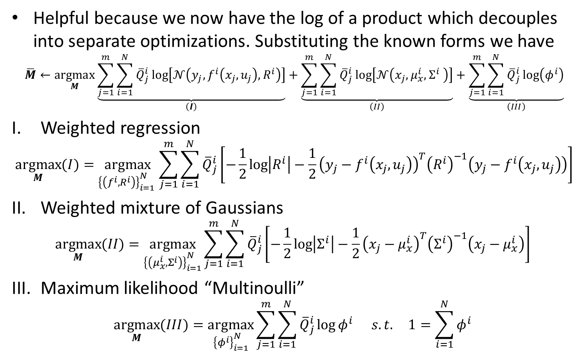
Maximization Step
Helpful because we now have the log of a product which decouples into separate optimizations. Substituting the known forms we have
$$\overline{M}←\underset{M}{argmax}{\underset{\left(I\right)}{\underbrace{\sum_{j=1}^{m}{\sum_{i=1}^{N}{{\overline{Q}}_{j}^{i}\log\left[𝒩\left(y_{j},f^{i}\left(x_{j},u_{j}\right),R^{i}\right)\right]}}}}+\underset{\left(II\right)}{\underbrace{\sum_{j=1}^{m}{\sum_{i=1}^{N}{{\overline{Q}}_{j}^{i}\log\left[𝒩\left(x_{j},μ_{x}^{i},Σ^{i} \right)\right]}}}}+\underset{\left(III\right)}{\underbrace{\sum_{j=1}^{m}{\sum_{i=1}^{N}{{\overline{Q}}_{j}^{i}\log\left(φ^{i}\right)}}}}}$$
Weighted regression
$$\underset{M}{argmax}{(I)}=\underset{{\left\{\left(f^{i},R^{i}\right)\right\}}_{i=1}^{N} }{argmax}{\sum_{j=1}^{m}{\sum_{i=1}^{N}{{\overline{Q}}_{j}^{i}\left[−\frac{1}{2}\log\left|R^{i}\right|−\frac{1}{2}{\left(y_{j}−f^{i}\left(x_{j},u_{j}\right)\right)}^{T}{\left(R^{i}\right)}^{−1}\left(y_{j}−f^{i}\left(x_{j},u_{j}\right)\right)\right]}}}$$
Weighted mixture of Gaussians
$$\underset{M}{argmax}{(II)}=\underset{{\left\{\left(μ_{x}^{i},Σ^{i}\right)\right\}}_{i=1}^{N}}{argmax}{\sum_{j=1}^{m}{\sum_{i=1}^{N}{{\overline{Q}}_{j}^{i}\left[−\frac{1}{2}\log\left|Σ^{i}\right|−\frac{1}{2}{\left(x_{j}−μ_{x}^{i}\right)}^{T}{\left(Σ^{i}\right)}^{−1}\left(x_{j}−μ_{x}^{i}\right)\right]}}}$$
Maximum likelihood “Multinoulli”
$$\underset{M}{argmax}{(III)}=\underset{{\left\{φ^{i}\right\}}_{i=1}^{N}}{argmax}{\sum_{j=1}^{m}{\sum_{i=1}^{N}{{\overline{Q}}_{j}^{i}\log{φ^{i}}}}} s.t. 1=\sum_{i=1}^{N}{φ^{i}}$$

Slide 13
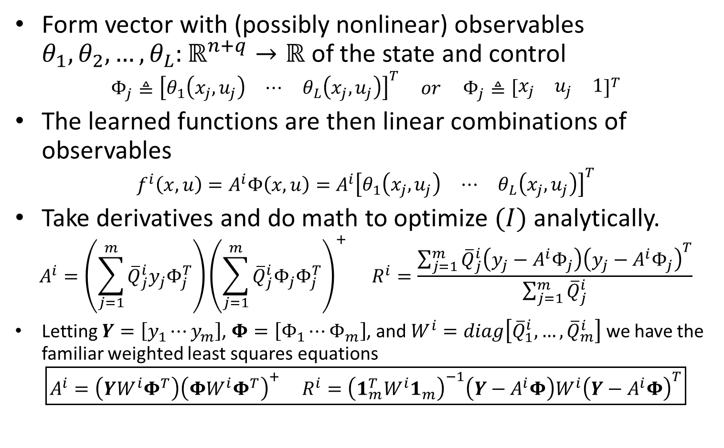
(I) Weighted Regression
Form vector with (possibly nonlinear) observables $θ_{1},θ_{2},…,θ_{L}:ℝ^{n+q}→ℝ$ of the state and control
$$Φ_{j}≜{\left[\begin{matrix}θ_{1}\left(x_{j},u_{j}\right) & ⋯ & θ_{L}\left(x_{j},u_{j}\right)\end{matrix}\right]}^{T} or Φ_{j}≜{\left[\begin{matrix}x_{j} & u_{j} & 1\end{matrix}\right]}^{T}$$
The learned functions are then linear combinations of observables
$$f^{i}\left(x,u\right)=A^{i}Φ\left(x,u\right)=A^{i}{\left[\begin{matrix}θ_{1}\left(x_{j},u_{j}\right) & ⋯ & θ_{L}\left(x_{j},u_{j}\right)\end{matrix}\right]}^{T}$$
Take derivatives and do math to optimize $(I)$ analytically.
$$A^{i}=\left(\sum_{j=1}^{m}{{\overline{Q}}_{j}^{i}y_{j}Φ_{j}^{T}}\right){\left(\sum_{j=1}^{m}{{\overline{Q}}_{j}^{i}Φ_{j}Φ_{j}^{T}}\right)}^{+} R^{i}=\frac{\sum_{j=1}^{m}{{\overline{Q}}_{j}^{i}\left(y_{j}−A^{i}Φ_{j}\right){\left(y_{j}−A^{i}Φ_{j}\right)}^{T}}}{\sum_{j=1}^{m}{{\overline{Q}}_{j}^{i}}}$$
Letting $Y=\left[y_{1}⋯y_{m}\right]$, $Φ=\left[Φ_{1}⋯Φ_{m}\right]$, and $W^{i}=diag\left[{\overline{Q}}_{1}^{i},…,{\overline{Q}}_{m}^{i}\right]$ we have the familiar weighted least squares equations
$$\boxed{A^{i}=\left(YW^{i}Φ^{T}\right){\left(ΦW^{i}Φ^{T}\right)}^{+} R^{i}={\left(1_{m}^{T}W^{i}1_{m}\right)}^{−1}\left(Y−A^{i}Φ\right)W^{i}{\left(Y−A^{i}Φ\right)}^{T}}$$

Slide 14
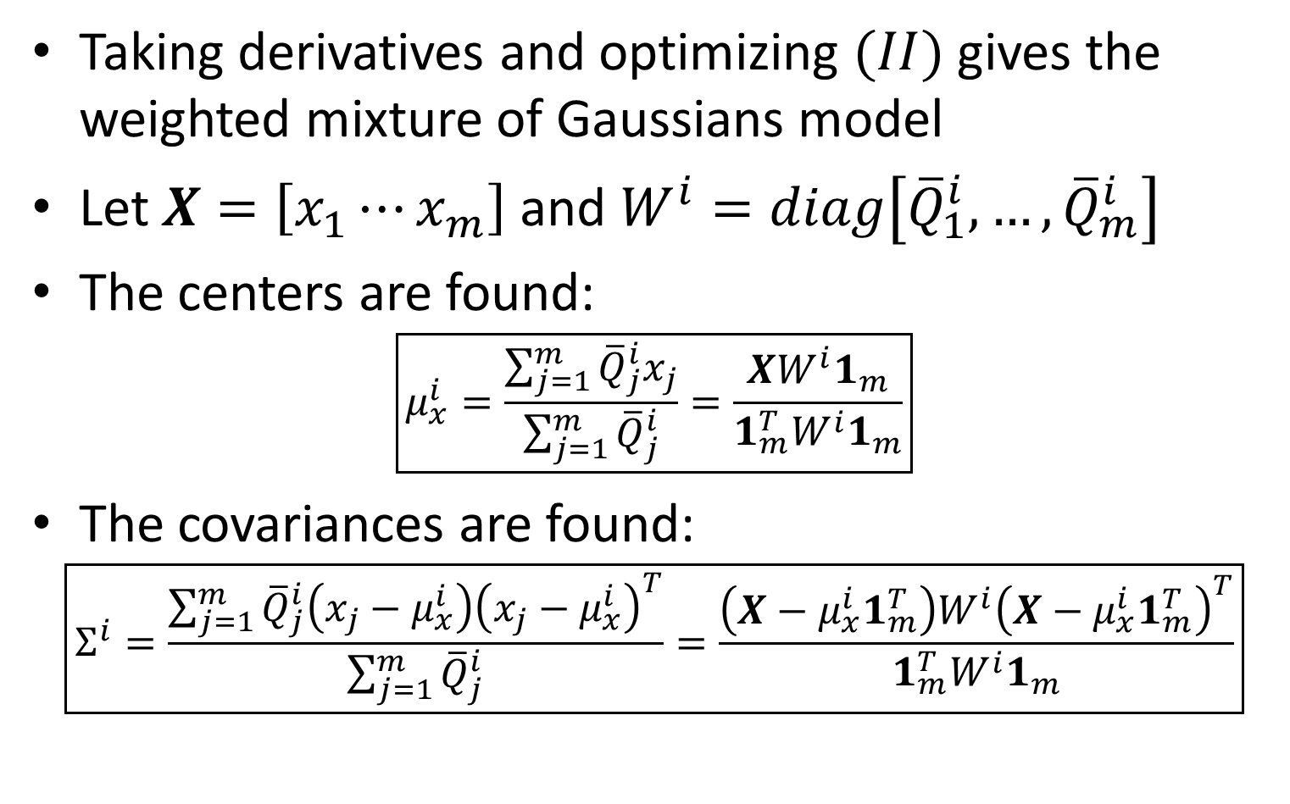
(II) Weighted Mixture of Gaussians
Taking derivatives and optimizing $(II)$ gives the weighted mixture of Gaussians model
Let $X=\left[x_{1}⋯x_{m}\right]$ and $W^{i}=diag\left[{\overline{Q}}_{1}^{i},…,{\overline{Q}}_{m}^{i}\right]$
The centers are found:
$$\boxed{μ_{x}^{i}=\frac{\sum_{j=1}^{m}{{\overline{Q}}_{j}^{i}x_{j}}}{\sum_{j=1}^{m}{{\overline{Q}}_{j}^{i}}}=\frac{XW^{i}1_{m}}{1_{m}^{T}W^{i}1_{m}}}$$
The covariances are found:
$$\boxed{Σ^{i}=\frac{\sum_{j=1}^{m}{{\overline{Q}}_{j}^{i}\left(x_{j}−μ_{x}^{i}\right){\left(x_{j}−μ_{x}^{i}\right)}^{T}}}{\sum_{j=1}^{m}{{\overline{Q}}_{j}^{i}}}=\frac{\left(X−μ_{x}^{i}1_{m}^{T}\right)W^{i}{\left(X−μ_{x}^{i}1_{m}^{T}\right)}^{T}}{1_{m}^{T}W^{i}1_{m}}}$$

Slide 15
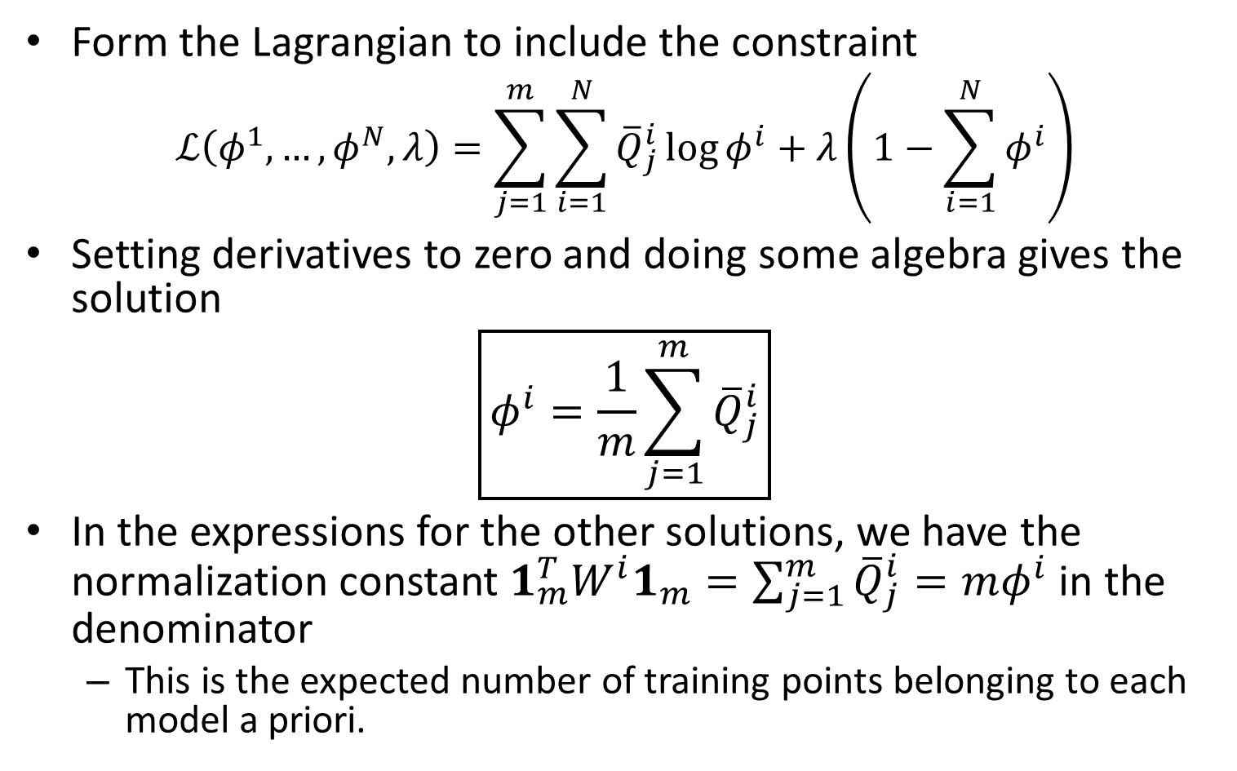
(III) Weighted Multinoulli
Form the Lagrangian to include the constraint
$$ℒ\left(φ^{1},…,φ^{N},λ\right)=\sum_{j=1}^{m}{\sum_{i=1}^{N}{{\overline{Q}}_{j}^{i}\log{φ^{i}}}}+λ\left(1−\sum_{i=1}^{N}{φ^{i}}\right)$$
Setting derivatives to zero and doing some algebra gives the solution
$$\boxed{φ^{i}=\frac{1}{m}\sum_{j=1}^{m}{{\overline{Q}}_{j}^{i}}}$$
In the expressions for the other solutions, we have the normalization constant $1_{m}^{T}W^{i}1_{m}=\sum_{j=1}^{m}{{\overline{Q}}_{j}^{i}}=mφ^{i}$ in the denominator
This is the expected number of training points belonging to each model a priori.

Slide 16
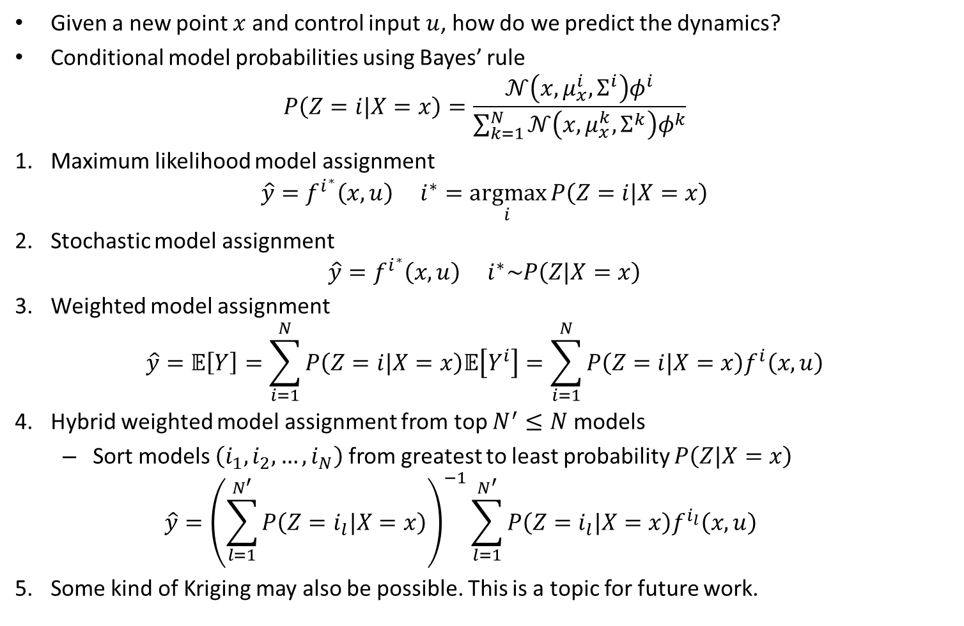
Reconstructing the Dynamics
Given a new point $x$ and control input $u$, how do we predict the dynamics?
Conditional model probabilities using Bayes’ rule
$$P\left(Z=i|X=x\right)=\frac{𝒩\left(x,μ_{x}^{i},Σ^{i}\right)φ^{i}}{\sum_{k=1}^{N}{𝒩\left(x,μ_{x}^{k},Σ^{k}\right)φ^{k}}}$$
Maximum likelihood model assignment
$$\hat{y}=f^{i^{∗}}\left(x,u\right) i^{∗}=\underset{i}{argmax}{P\left(Z=i|X=x\right)}$$
Stochastic model assignment
$$\hat{y}=f^{i^{∗}}\left(x,u\right) i^{∗}\sim P\left(Z|X=x\right)$$
Weighted model assignment
$$\hat{y}=𝔼\left[Y\right]=\sum_{i=1}^{N}{P\left(Z=i|X=x\right)𝔼\left[Y^{i}\right]}=\sum_{i=1}^{N}{P\left(Z=i|X=x\right)f^{i}\left(x,u\right)}$$
Hybrid weighted model assignment from top $N^{′}≤N$ models
Sort models $\left(i_{1},i_{2},…,i_{N}\right)$ from greatest to least probability $P\left(Z|X=x\right)$
$$\hat{y}={\left(\sum_{l=1}^{N^{′}}{P\left(Z=i_{l}|X=x\right)}\right)}^{−1}\sum_{l=1}^{N^{′}}{P\left(Z=i_{l}|X=x\right)f^{i_{l}}\left(x,u\right)}$$
Some kind of Kriging may also be possible. This is a topic for future work.

Slide 17
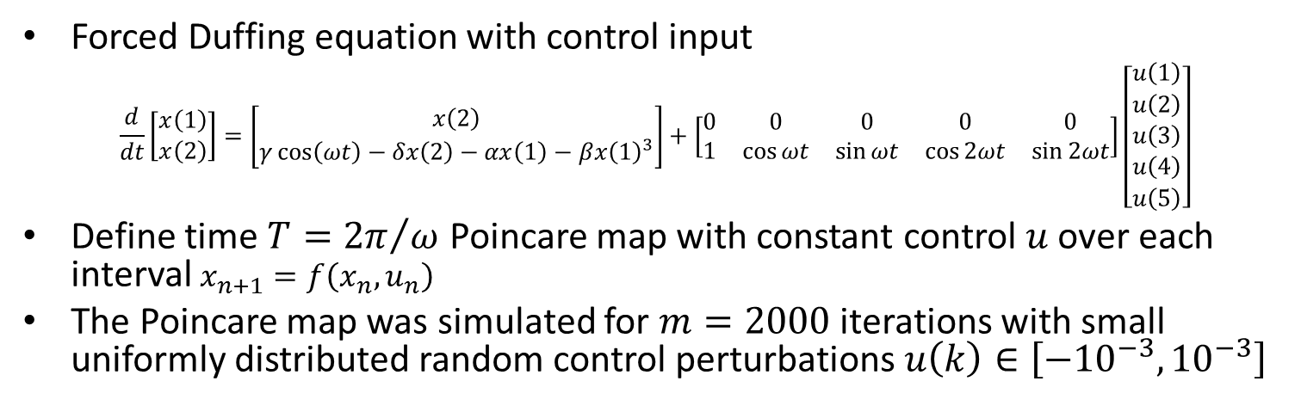
Application to Duffing Equation with Control
Forced Duffing equation with control input
$$\frac{d}{dt}\left[\begin{aligned}x\left(1\right) \\ x\left(2\right)\end{aligned}\right]=\left[\begin{aligned}x\left(2\right) \\ γ\cos\left(ωt\right)−δx\left(2\right)−αx\left(1\right)−βx{\left(1\right)}^{3}\end{aligned}\right]+\left[\begin{matrix}0 & 0 & 0 & 0 & 0 \\ 1 & \cos{ωt} & \sin{ωt} & \cos{2ωt} & \sin{2ωt}\end{matrix}\right]\left[\begin{aligned}u\left(1\right) \\ u\left(2\right) \\ u\left(3\right) \\ u\left(4\right) \\ u\left(5\right)\end{aligned}\right]$$
Define time $T={2π}/ω$ Poincare map with constant control $u$ over each interval $x_{n+1}=f\left(x_{n},u_{n}\right)$
The Poincare map was simulated for $m=2000$ iterations with small uniformly distributed random control perturbations $u\left(k\right)∈\left[−{10}^{−3},{10}^{−3}\right]$

Slide 18
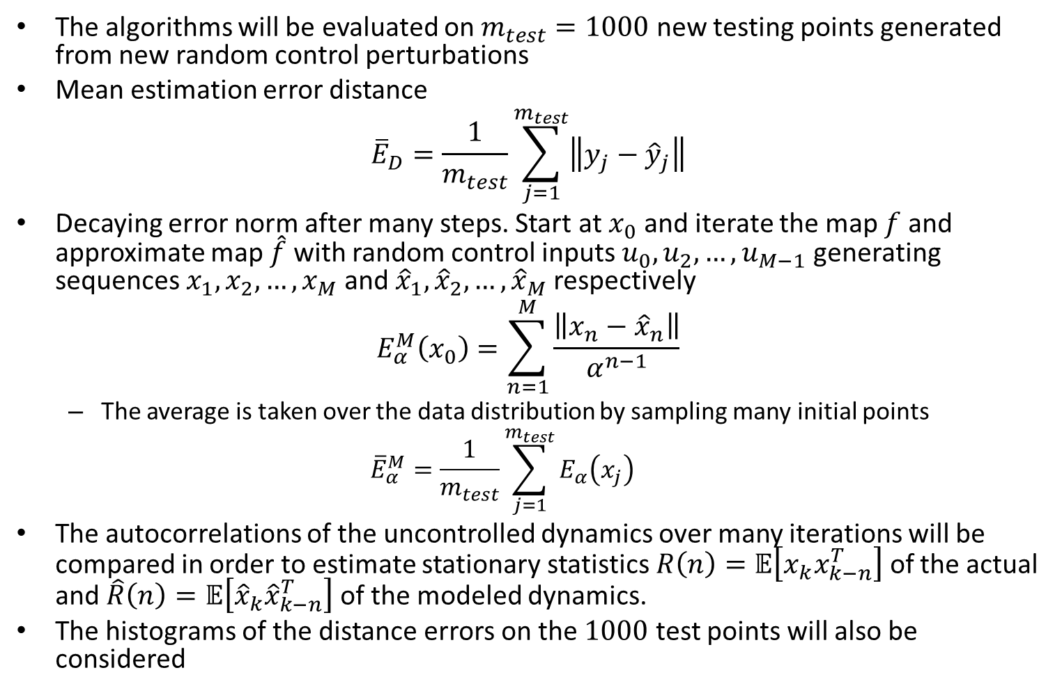
Error Metrics
The algorithms will be evaluated on $m_{test}=1000$ new testing points generated from new random control perturbations
Mean estimation error distance
$${\overline{E}}_{D}=\frac{1}{m_{test}}\sum_{j=1}^{m_{test}}{\left\|y_{j}−{\hat{y}}_{j}\right\|}$$
Decaying error norm after many steps. Start at $x_{0}$ and iterate the map $f$ and approximate map $\hat{f}$ with random control inputs $u_{0},u_{2},…,u_{M−1}$ generating sequences $x_{1},x_{2},…,x_{M}$ and ${\hat{x}}_{1},{\hat{x}}_{2},…,{\hat{x}}_{M}$ respectively
$$E_{α}^{M}\left(x_{0}\right)=\sum_{n=1}^{M}{\frac{\left\|x_{n}−{\hat{x}}_{n}\right\|}{α^{n−1}}}$$
The average is taken over the data distribution by sampling many initial points
$${\overline{E}}_{α}^{M}=\frac{1}{m_{test}}\sum_{j=1}^{m_{test}}{E_{α}\left(x_{j}\right)}$$
The autocorrelations of the uncontrolled dynamics over many iterations will be compared in order to estimate stationary statistics $R\left(n\right)=𝔼\left[x_{k}x_{k−n}^{T}\right]$ of the actual and $\hat{R}\left(n\right)=𝔼\left[{\hat{x}}_{k}{\hat{x}}_{k−n}^{T}\right]$ of the modeled dynamics.
The histograms of the distance errors on the $1000$ test points will also be considered

Slide 19
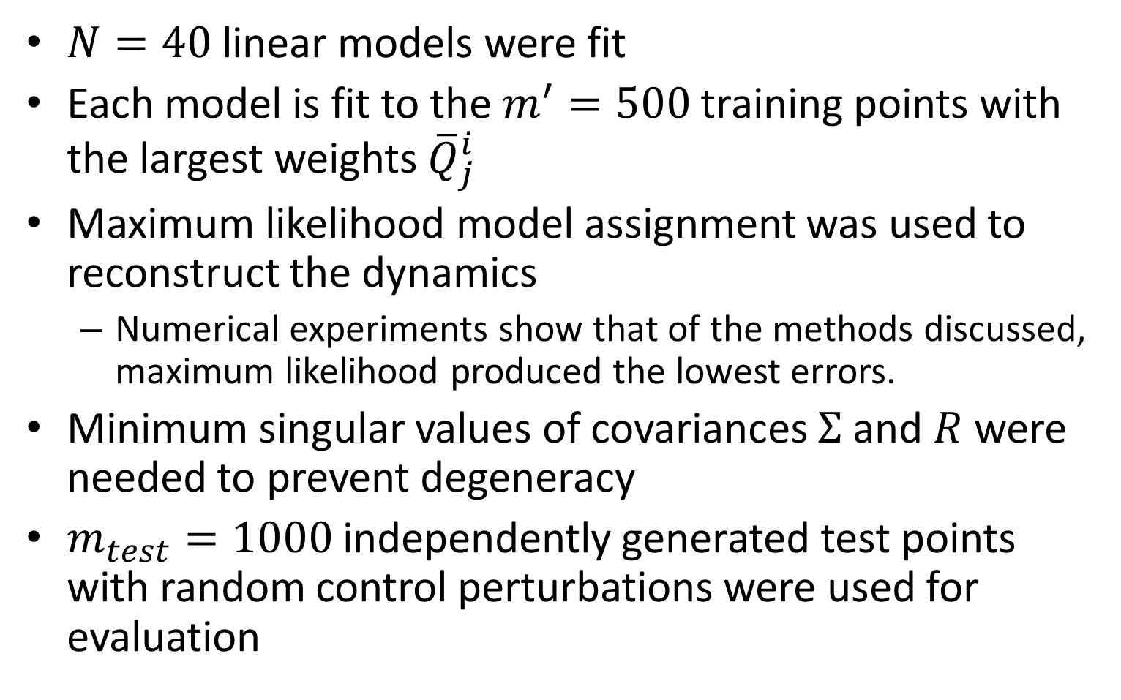
Linear EM Gaussian Mixture Results
$N=40$ linear models were fit
Each model is fit to the $m^{′}=500$ training points with the largest weights ${\overline{Q}}_{j}^{i}$
Maximum likelihood model assignment was used to reconstruct the dynamics
Numerical experiments show that of the methods discussed, maximum likelihood produced the lowest errors.
Minimum singular values of covariances $Σ$ and $R$ were needed to prevent degeneracy
$m_{test}=1000$ independently generated test points with random control perturbations were used for evaluation

Slide 20
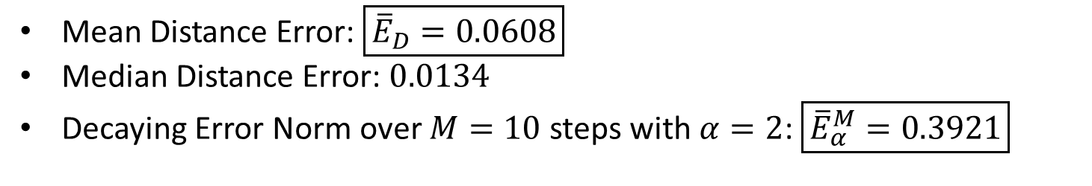
Linear EM Gaussian Mixture Results
Mean Distance Error: $\boxed{{\overline{E}}_{D}=0.0608}$
Median Distance Error: $0.0134$
Decaying Error Norm over $M=10$ steps with $α=2$: $\boxed{{\overline{E}}_{α}^{M}=0.3921}$

Slide 21
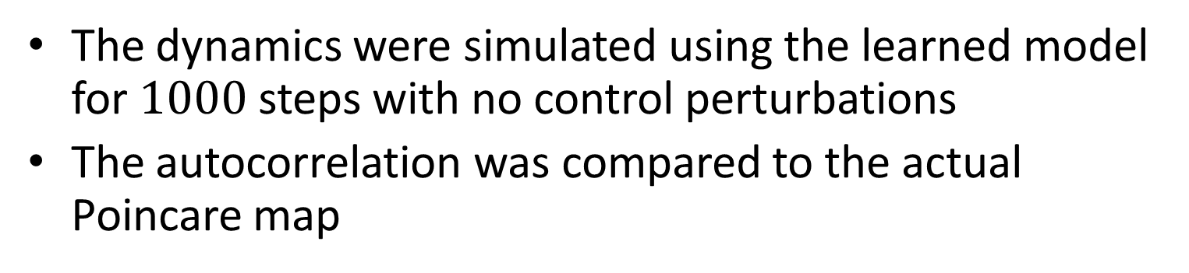
Use as a Generative Model
The dynamics were simulated using the learned model for $1000$ steps with no control perturbations
The autocorrelation was compared to the actual Poincare map

Slide 22
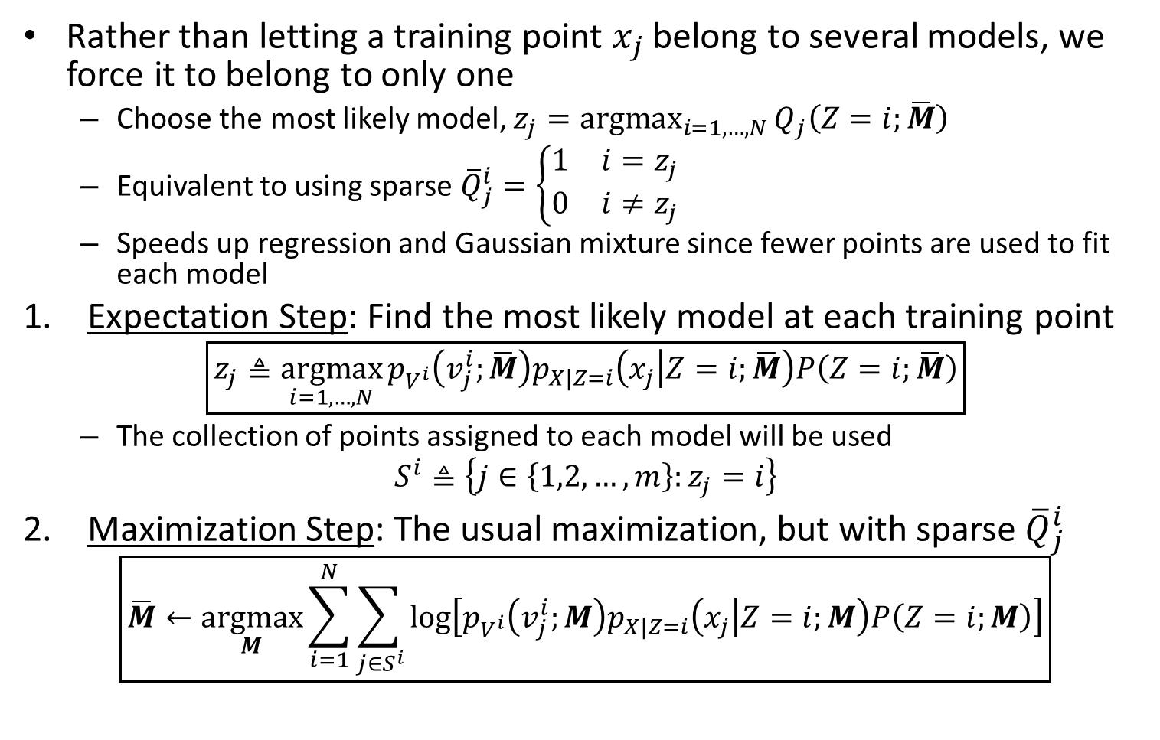
Simplified EM: K-Means
Rather than letting a training point $x_{j}$ belong to several models, we force it to belong to only one
Choose the most likely model, $z_{j}=\underset{i=1,…,N}{argmax}{Q_{j}\left(Z=i;\overline{M}\right)}$
Equivalent to using sparse ${\overline{Q}}_{j}^{i}=\left\{\begin{matrix}1 & i=z_{j} \\ 0 & i≠z_{j}\end{matrix}\right.$
Speeds up regression and Gaussian mixture since fewer points are used to fit each model
Expectation Step: Find the most likely model at each training point
$$\boxed{z_{j}≜\underset{i=1,…,N}{argmax}{p_{V^{i}}\left(v_{j}^{i};\overline{M}\right)p_{X|Z=i}\left(x_{j} | Z=i;\overline{M}\right)P\left(Z=i;\overline{M}\right)}}$$
The collection of points assigned to each model will be used
$$S^{i}≜\left\{j∈\left\{1,2,…,m\right\}:z_{j}=i\right\}$$
Maximization Step: The usual maximization, but with sparse ${\overline{Q}}_{j}^{i}$
$$\boxed{\overline{M}←\underset{M}{argmax}{\sum_{i=1}^{N}{\sum_{j∈S^{i}}{\log\left[p_{V^{i}}\left(v_{j}^{i};M\right)p_{X|Z=i}\left(x_{j} | Z=i;M\right)P\left(Z=i;M\right)\right]}}}}$$

Slide 23
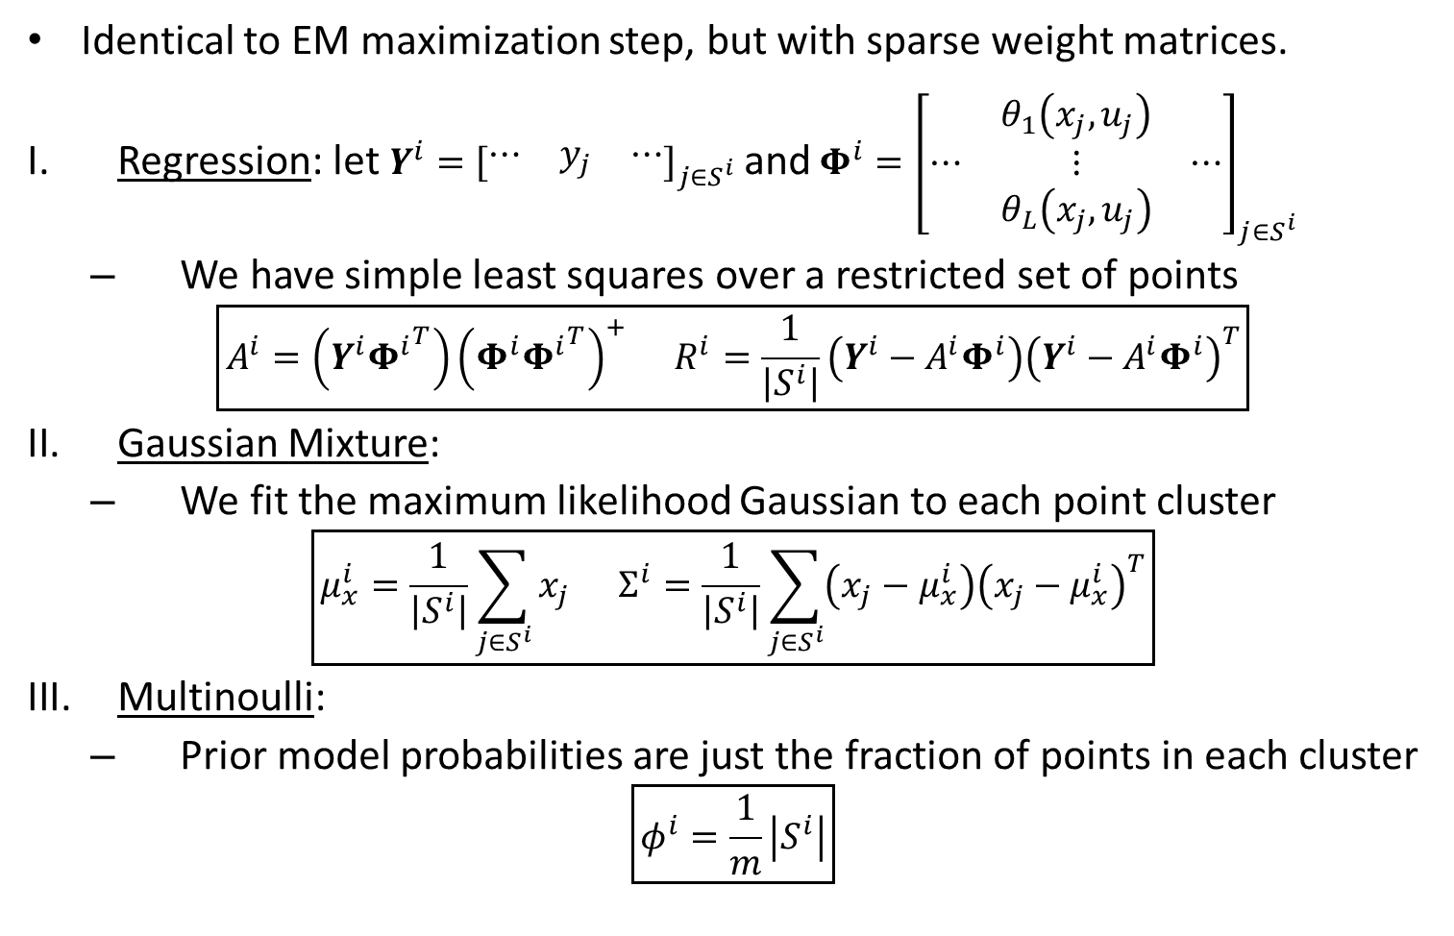
K-Means Maximization Step
Identical to EM maximization step, but with sparse weight matrices.
Regression: let $Y^{i}={\left[\begin{matrix}⋯ & y_{j} & ⋯\end{matrix}\right]}_{j∈S^{i}}$ and $Φ^{i}={\left[\begin{matrix}⋯ & \begin{aligned}θ_{1}\left(x_{j},u_{j}\right) \\ ⋮ \\ θ_{L}\left(x_{j},u_{j}\right)\end{aligned} & ⋯\end{matrix}\right]}_{j∈S^{i}}$
We have simple least squares over a restricted set of points
$$\boxed{A^{i}=\left(Y^{i}{Φ^{i}}^{T}\right){\left(Φ^{i}{Φ^{i}}^{T}\right)}^{+} R^{i}=\frac{1}{\left|S^{i}\right|}\left(Y^{i}−A^{i}Φ^{i}\right){\left(Y^{i}−A^{i}Φ^{i}\right)}^{T}}$$
Gaussian Mixture:
We fit the maximum likelihood Gaussian to each point cluster
$$\boxed{μ_{x}^{i}=\frac{1}{\left|S^{i}\right|}\sum_{j∈S^{i}}{x_{j}} Σ^{i}=\frac{1}{\left|S^{i}\right|}\sum_{j∈S^{i}}{\left(x_{j}−μ_{x}^{i}\right){\left(x_{j}−μ_{x}^{i}\right)}^{T}}}$$
Multinoulli:
Prior model probabilities are just the fraction of points in each cluster
$$\boxed{φ^{i}=\frac{1}{m}\left|S^{i}\right|}$$

Slide 24
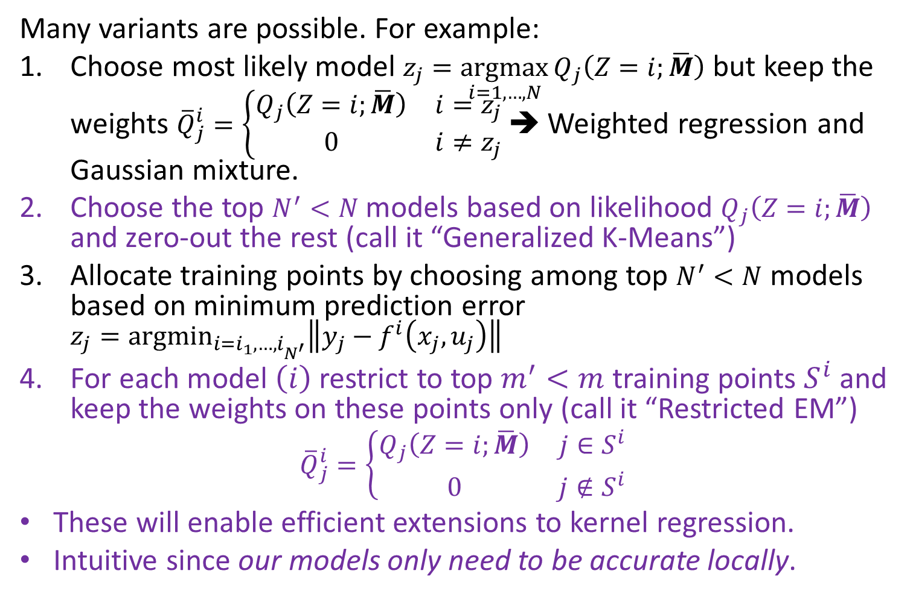
K-Means/EM Variants
Many variants are possible. For example:
Choose most likely model $z_{j}=\underset{i=1,…,N}{argmax}{Q_{j}\left(Z=i;\overline{M}\right)}$ but keep the weights ${\overline{Q}}_{j}^{i}=\left\{\begin{matrix}Q_{j}\left(Z=i;\overline{M}\right) & i=z_{j} \\ 0 & i≠z_{j}\end{matrix}\right.$ ➔ Weighted regression and Gaussian mixture.
Choose the top $N^{′}<N$ models based on likelihood $Q_{j}\left(Z=i;\overline{M}\right)$ and zero-out the rest (call it “Generalized K-Means”)
Allocate training points by choosing among top $N^{′}<N$ models based on minimum prediction error $z_{j}=\underset{i=i_{1},…,i_{N^{′}}}{argmin}\left\|y_{j}−f^{i}\left(x_{j},u_{j}\right)\right\|$
For each model $\left(i\right)$ restrict to top $m^{′}<m$ training points $S^{i}$ and keep the weights on these points only (call it “Restricted EM”)
$${\overline{Q}}_{j}^{i}=\left\{\begin{matrix}Q_{j}\left(Z=i;\overline{M}\right) & j∈S^{i} \\ 0 & j∉S^{i}\end{matrix}\right.$$
These will enable efficient extensions to kernel regression.
Intuitive since our models only need to be accurate locally.

Slide 25
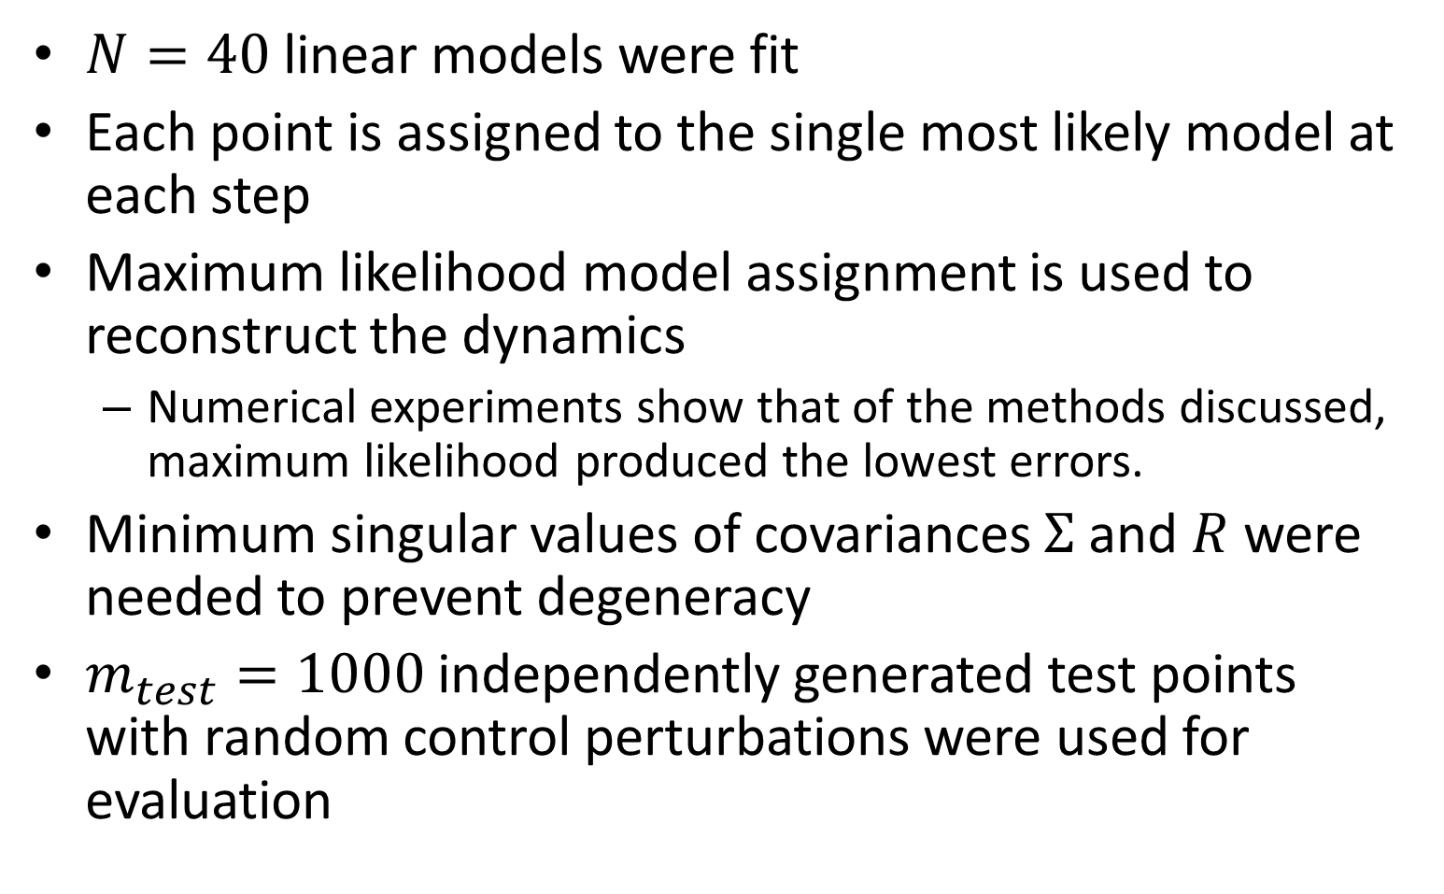
Linear K-Means Gaussian Mixture Results
$N=40$ linear models were fit
Each point is assigned to the single most likely model at each step
Maximum likelihood model assignment is used to reconstruct the dynamics
Numerical experiments show that of the methods discussed, maximum likelihood produced the lowest errors.
Minimum singular values of covariances $Σ$ and $R$ were needed to prevent degeneracy
$m_{test}=1000$ independently generated test points with random control perturbations were used for evaluation

Slide 26
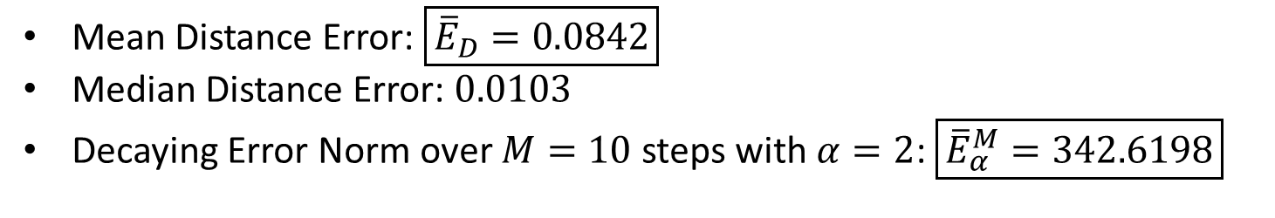
Linear K-Means Gaussian Mixture Results
Mean Distance Error: $\boxed{{\overline{E}}_{D}=0.0842}$
Median Distance Error: $0.0103$
Decaying Error Norm over $M=10$ steps with $α=2$: $\boxed{{\overline{E}}_{α}^{M}=342.6198}$

Slide 27
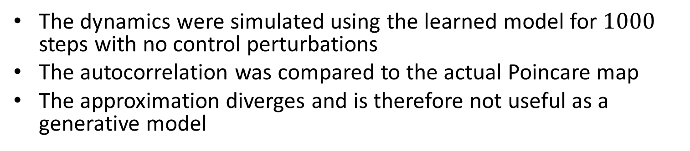
Use as a Generative Model
The dynamics were simulated using the learned model for $1000$ steps with no control perturbations
The autocorrelation was compared to the actual Poincare map
The approximation diverges and is therefore not useful as a generative model

Slide 28
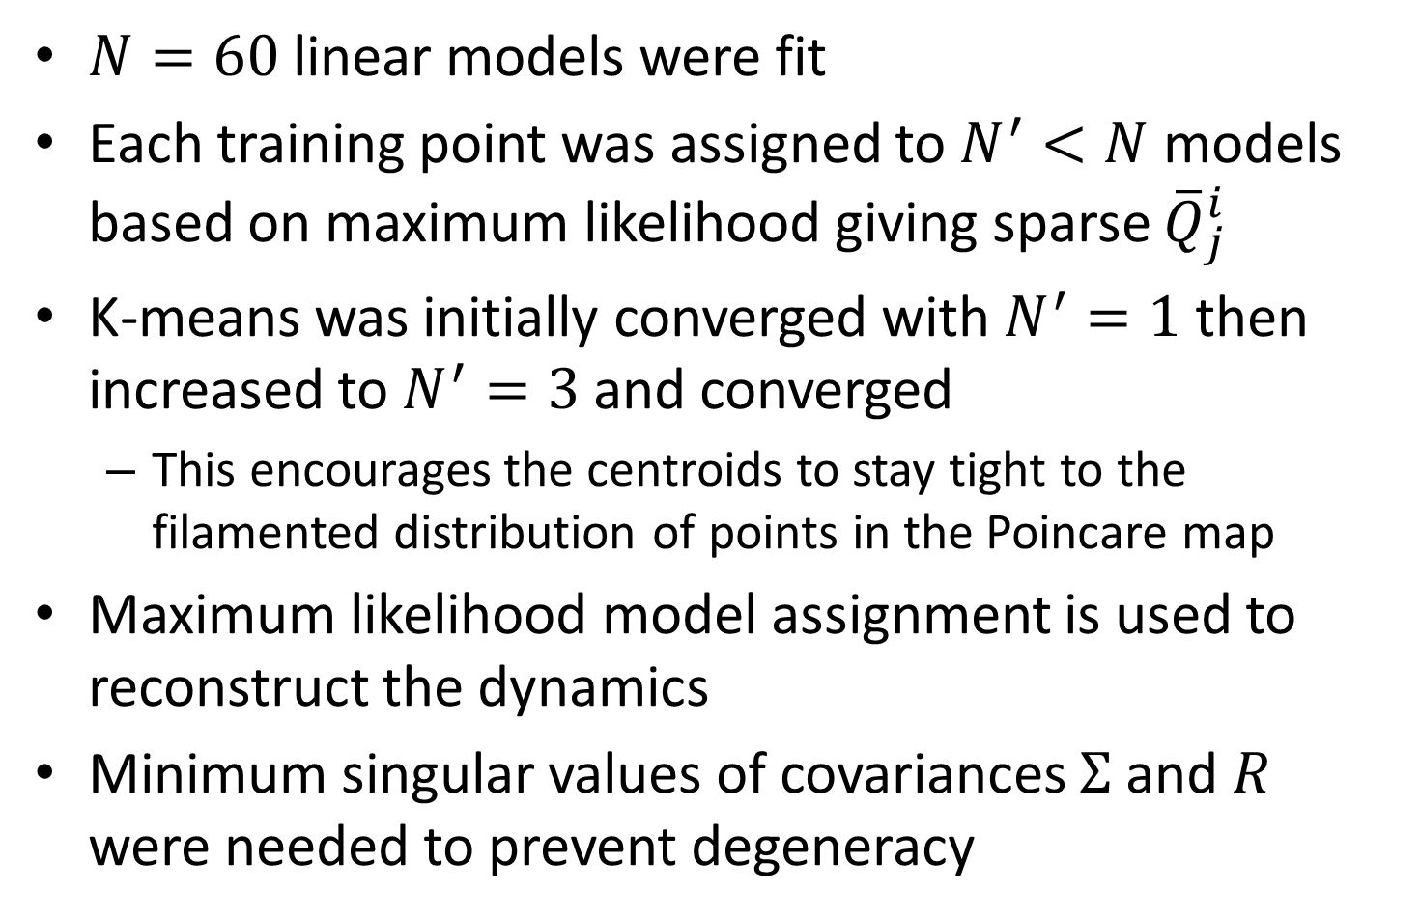
Linear Generalized K-Means Results
$N=60$ linear models were fit
Each training point was assigned to $N^{′}<N$ models based on maximum likelihood giving sparse ${\overline{Q}}_{j}^{i}$
K-means was initially converged with $N^{′}=1$ then increased to $N^{′}=3$ and converged
This encourages the centroids to stay tight to the filamented distribution of points in the Poincare map
Maximum likelihood model assignment is used to reconstruct the dynamics
Minimum singular values of covariances $Σ$ and $R$ were needed to prevent degeneracy

Slide 29
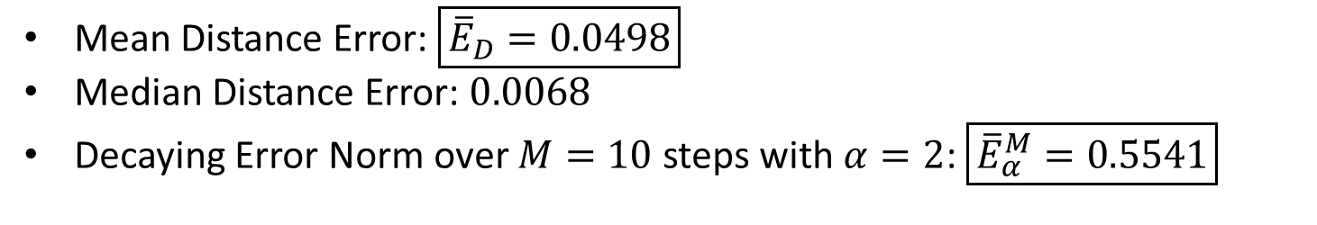
Linear Generalized K-Means Results
Mean Distance Error: $\boxed{{\overline{E}}_{D}=0.0498}$
Median Distance Error: $0.0068$
Decaying Error Norm over $M=10$ steps with $α=2$: $\boxed{{\overline{E}}_{α}^{M}=0.5541}$

Slide 30
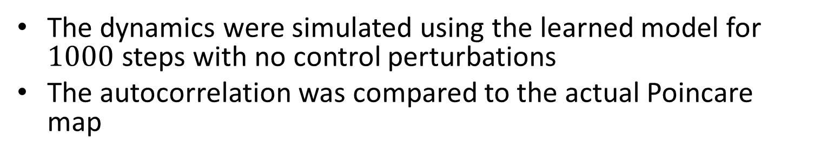
Use as a Generative Model
The dynamics were simulated using the learned model for $1000$ steps with no control perturbations
The autocorrelation was compared to the actual Poincare map

Slide 31
Highlights from Linear Cases
Generalized K-means where points can be assigned to multiple models attains the lowest error with a large number of models
The K-means and generalized K-means centroids fit the data more tightly than EM.
K-means and generalized K-means both take less time to converge than EM even with the restricted set of points used to train each model.
Linear models are very useful
Local DMD
Linear models are still too inaccurate to replicate the dynamics over multiple steps
Nonlinear kernel models will now be developed

Slide 32
Extending to Nonlinear Local Dynamics
As we have seen, the local dynamics can be highly nonlinear
The number of linear models that can be fit is limited by the number of training points
Cannot provide adequate resolution in areas with high nonlinearity unless they are accompanied by a high density of training point
We would like to model nonlinear local variations efficiently without over-fitting.
Must be able to include local weighting when fitting the nonlinear model
These requirements suggest using weighted kernel ridge regression.

Slide 33
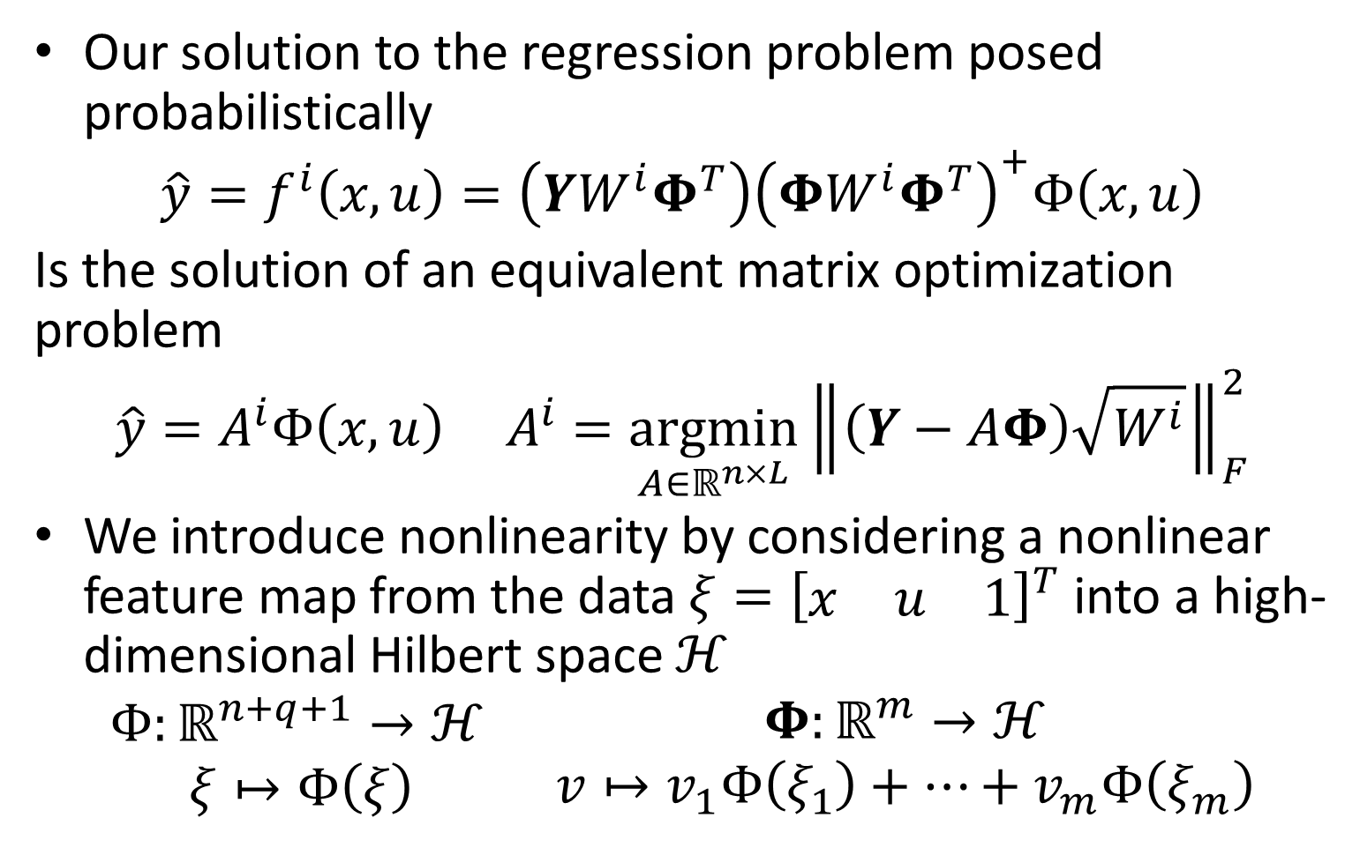
Weighted Kernel Ridge Regression
Our solution to the regression problem posed probabilistically
$$\hat{y}=f^{i}\left(x,u\right)=\left(YW^{i}Φ^{T}\right){\left(ΦW^{i}Φ^{T}\right)}^{+}Φ\left(x,u\right)$$
Is the solution of an equivalent matrix optimization problem
$$\hat{y}=A^{i}Φ\left(x,u\right) A^{i}=\underset{A∈ℝ^{n×L}}{argmin}{{\left\|\left(Y−AΦ\right)\sqrt{W^{i}}\right\|}_{F}^{2}}$$
We introduce nonlinearity by considering a nonlinear feature map from the data $ξ={\left[\begin{matrix}x & u & 1\end{matrix}\right]}^{T}$ into a high-dimensional Hilbert space $ℋ$
$$\begin{matrix}Φ:ℝ^{n+q+1}→ℋ \\ ξ↦Φ\left(ξ\right)\end{matrix} \begin{matrix}Φ:ℝ^{m}→ℋ \\ v↦v_{1}Φ\left(ξ_{1}\right)+⋯+v_{m}Φ\left(ξ_{m}\right)\end{matrix}$$

Slide 34
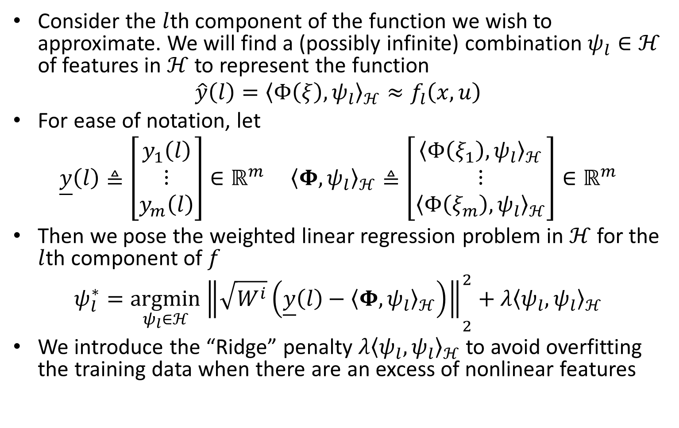
Weighted Kernel Ridge Regression
Consider the $l$th component of the function we wish to approximate. We will find a (possibly infinite) combination $ψ_{l}∈ℋ$ of features in $ℋ$ to represent the function
$$\hat{y}\left(l\right)={\left\langle Φ\left(ξ\right),ψ_{l}\right\rangle }_{ℋ}≈f_{l}\left(x,u\right)$$
For ease of notation, let
$$\underline{y}\left(l\right)≜\left[\begin{aligned}y_{1}\left(l\right) \\ ⋮ \\ y_{m}\left(l\right)\end{aligned}\right]∈ℝ^{m} {\left\langle Φ,ψ_{l}\right\rangle }_{ℋ}≜\left[\begin{aligned}{\left\langle Φ\left(ξ_{1}\right),ψ_{l}\right\rangle }_{ℋ} \\ ⋮ \\ {\left\langle Φ\left(ξ_{m}\right),ψ_{l}\right\rangle }_{ℋ}\end{aligned}\right]∈ℝ^{m}$$
Then we pose the weighted linear regression problem in $ℋ$ for the $l$th component of $f$
$$ψ_{l}^{∗}={\underset{ψ_{l}∈ℋ}{argmin}\left\|\sqrt{W^{i}}\left(\underline{y}\left(l\right)−{\left\langle Φ,ψ_{l}\right\rangle }_{ℋ}\right)\right\|}_{2}^{2}+λ{\left\langle ψ_{l},ψ_{l}\right\rangle }_{ℋ}$$
We introduce the “Ridge” penalty $λ{\left\langle ψ_{l},ψ_{l}\right\rangle }_{ℋ}$ to avoid overfitting the training data when there are an excess of nonlinear features

Slide 35
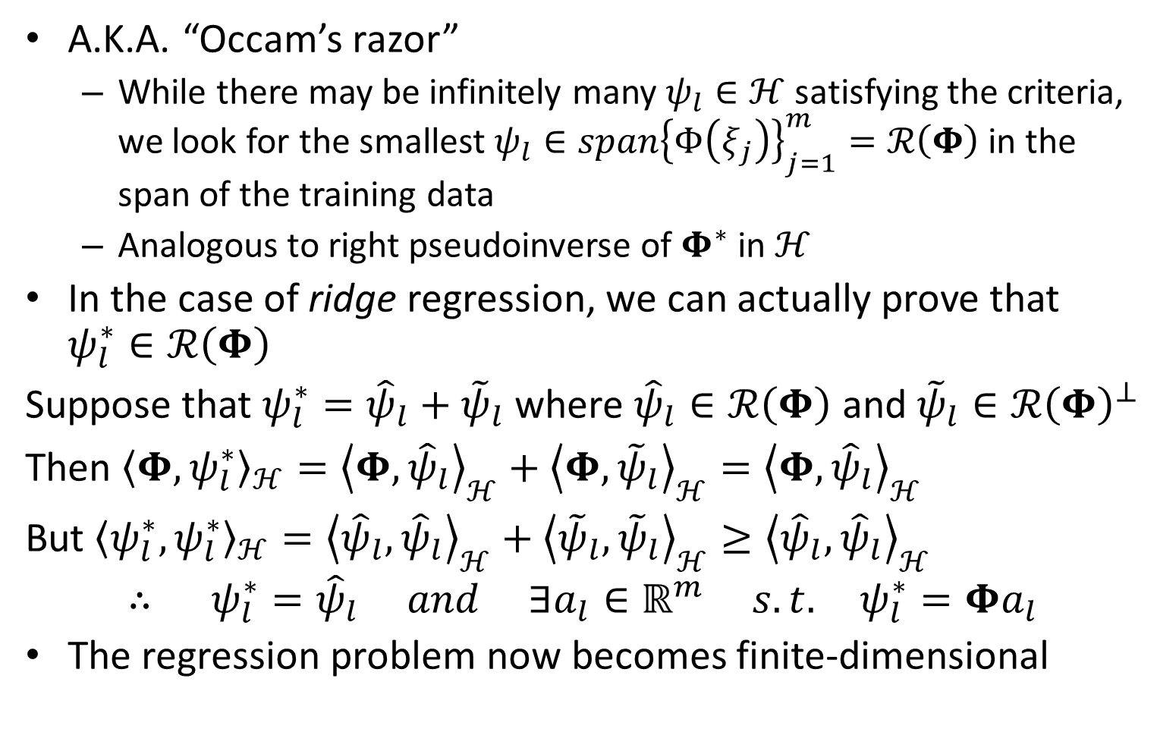
Learning Subspace Property (LSP)
A.K.A. “Occam’s razor”
While there may be infinitely many $ψ_{l}∈ℋ$ satisfying the criteria, we look for the smallest $ψ_{l}∈span{\left\{Φ\left(ξ_{j}\right)\right\}}_{j=1}^{m}=ℛ\left(Φ\right)$ in the span of the training data
Analogous to right pseudoinverse of $Φ^{∗}$ in $ℋ$
In the case of ridge regression, we can actually prove that $ψ_{l}^{∗}∈ℛ\left(Φ\right)$
Suppose that $ψ_{l}^{∗}={\hat{ψ}}_{l}+{\tilde{ψ}}_{l}$ where ${\hat{ψ}}_{l}∈ℛ\left(Φ\right)$ and ${\tilde{ψ}}_{l}∈ℛ{\left(Φ\right)}^{⊥}$
Then ${\left\langle Φ,ψ_{l}^{∗}\right\rangle }_{ℋ}={\left\langle Φ,{\hat{ψ}}_{l}\right\rangle }_{ℋ}+{\left\langle Φ,{\tilde{ψ}}_{l}\right\rangle }_{ℋ}={\left\langle Φ,{\hat{ψ}}_{l}\right\rangle }_{ℋ}$
But ${\left\langle ψ_{l}^{∗},ψ_{l}^{∗}\right\rangle }_{ℋ}={\left\langle {\hat{ψ}}_{l},{\hat{ψ}}_{l}\right\rangle }_{ℋ}+{\left\langle {\tilde{ψ}}_{l},{\tilde{ψ}}_{l}\right\rangle }_{ℋ}≥{\left\langle {\hat{ψ}}_{l},{\hat{ψ}}_{l}\right\rangle }_{ℋ}$
$$∴ ψ_{l}^{∗}={\hat{ψ}}_{l} and ∃a_{l}∈ℝ^{m} s.t. ψ_{l}^{∗}=Φa_{l}$$
The regression problem now becomes finite-dimensional

Slide 36

Weighted Kernel Ridge Regression
Use LSP to express $ψ_{l}=Φa_{l}={a_{l}}_{1}Φ\left(ξ_{1}\right)+…+{a_{l}}_{m}Φ\left(ξ_{m}\right)$
$$a_{l}^{∗}={\underset{a_{l}∈ℝ^{m}}{argmin}\left\|\sqrt{W^{i}}\left(\underline{y}\left(l\right)−\sum_{j=1}^{m}{{\left\langle Φ,Φ\left(ξ_{j}\right) \right\rangle }_{ℋ}{a_{l}}_{j}}\right)\right\|}_{2}^{2}+λ\sum_{i,j=1}^{m}{{a_{l}}_{i}{a_{l}}_{j}{\left\langle Φ\left(ξ_{i}\right),Φ\left(ξ_{j}\right)\right\rangle }_{ℋ}}$$
Let $K≜{\left\langle Φ,Φ\right\rangle }_{ℋ}≜{\left[{\left\langle Φ\left(ξ_{i}\right),Φ\left(ξ_{j}\right)\right\rangle }_{ℋ}\right]}_{1≤i,j≤m}∈ℝ^{m×m}$ and do some simple manipulation
$$a_{l}^{∗}={\underset{a_{l}∈ℝ^{m}}{argmin}\left\|\sqrt{W^{i}}\left(\underline{y}\left(l\right)−Ka_{l}\right)\right\|}_{2}^{2}+λa_{l}^{T}Ka_{l}$$
$$a_{l}^{∗}={\underset{a_{l}∈ℝ^{m}}{argmin}\left\|\left[\begin{aligned}\sqrt{W^{i}}\underline{y}\left(l\right) \\ 0\end{aligned}\right]−\left[\begin{aligned}\sqrt{W^{i}}K \\ \sqrt{λK}\end{aligned}\right]a_{l}\right\|}_{2}^{2}$$
The above is now a standard $m$-dimensional least squares problem whose solution is
$$a_{l}^{∗}={\left(W^{i}K+λI_{m}\right)}^{−1}W^{i}\underline{y}\left(l\right)$$
$$∴ \hat{y}\left(l\right)={\left\langle Φ\left(ξ\right),ψ_{l}^{∗}\right\rangle }_{ℋ}={\left\langle Φ\left(ξ\right),Φ \right\rangle }_{ℋ}{\left(W^{i}K+λI_{m}\right)}^{−1}W^{i}\underline{y}\left(l\right)$$

Slide 37

Weighted Kernel Ridge Regression
Notice that the entire solution to the regression problem is expressed in terms of inner products of elements in $ℋ$
Introduce kernel function $𝓀\left(ξ,η\right)≜{\left\langle Φ\left(ξ\right),Φ\left(η\right)\right\rangle }_{ℋ}∈ℝ$ and $𝓴\left(ξ\right)≜{\left\langle Φ,Φ\left(ξ\right)\right\rangle }_{ℋ}∈ℝ^{m}$
Then the full estimator for the function is given by
$$\boxed{\hat{y}=f^{i}\left(x,u\right)=YW^{i}{\left(KW^{i}+λI_{m}\right)}^{−1}𝓴\left(ξ\right) K={\left[𝓀\left(ξ_{i},ξ_{j} \right)\right]}_{1≤i,j≤m} ξ=\left[\begin{aligned}x \\ u \\ 1\end{aligned}\right]}$$
This approximation is easily differentiated if we know the derivative of the kernel with respect to one of its slots $D_{ξ}𝓀\left(ξ_{0},ξ\right)$ allowing us to find $D_{ξ}𝓴\left(ξ_{0}\right)∈ℝ^{m×m}$
$$\boxed{D_{ξ}f^{i}\left(ξ_{0}\right)Δξ=YW^{i}{\left(KW^{i}+λI_{m}\right)}^{−1}D_{ξ}𝓴\left(ξ_{0}\right)Δξ }$$

Slide 38

Kernel Regression Implementation
It is prohibitively expensive to invert the $\left(KW^{i}+λI_{m}\right)∈ℝ^{m×m}$ each time the models are updated
We therefore choose only the largest $m^{′}<m$ weights $\left\{{\overline{Q}}_{j_{1}}^{i},{\overline{Q}}_{j_{2}}^{i},…,{\overline{Q}}_{j_{m^{′}}}^{i}\right\}$ on training points $S^{i}=\left\{j_{1},j_{2},…,j_{m^{′}}\right\}$ to be nonzero. ➔ “Restricted EM”
With the intention of doing local modeling, this is a sensible thing to do to speed up the algorithm
Forming the sub-matrices
$$\tilde{K}={\left[K_{i_{r}j_{s}}\right]}_{1≤r,s≤m^{′}} \tilde{W}=diag{\left\{{\overline{Q}}_{j_{r}}^{i}\right\}}_{1≤r≤m} \tilde{Y}=\left[y_{j_{1}}⋯y_{j_{m^{′}}}\right]$$
$$\tilde{𝓴}\left(ξ\right)={\left[\begin{matrix}{\left\langle Φ\left(ξ_{j_{1}}\right),ψ_{l}\right\rangle }_{ℋ} & ⋯ & {\left\langle Φ\left(ξ_{j_{m^{′}}}\right),ψ_{l}\right\rangle }_{ℋ}\end{matrix}\right]}^{T}$$
Using the Schur complement, we find that
$$\hat{y}=f^{i}\left(x,u\right)=\tilde{Y}{\tilde{W}}^{i}{\left(\tilde{K}{\tilde{W}}^{i}+λI_{m^{′}}\right)}^{−1}\tilde{𝓴}\left(ξ\right)$$

Slide 39

Application to Duffing Equation with Control (Restricted EM Algorithm)
$N=20$ models were fit using the RBF kernel with $σ=0.1$ and small $λ=5∗{10}^{−4}$
$$𝓴\left(x,z\right)=\exp\left(−\frac{1}{2σ^{2}}{\left\|x−z\right\|}_{2}^{2}\right)$$
Each model is fit to the $m^{′}=500$ training points with the largest weights ${\overline{Q}}_{j}^{i}$
Maximum likelihood model assignment was used to reconstruct the dynamics
Numerical experiments show that of the methods discussed, maximum likelihood produced the lowest errors.
Minimum singular values of covariances $Σ$ and $R$ were needed to prevent degeneracy
$m_{test}=1000$ independently generated test points with random control perturbations were used for evaluation

Slide 40

Nonlinear Restricted EM Results
Mean Distance Error: $\boxed{{\overline{E}}_{D}=0.0209}$
Median Distance Error: $0.0014$
Decaying Error Norm over $M=10$ steps with $α=2$: $\boxed{{\overline{E}}_{α}^{M}=0.1196}$

Slide 41
Use as a Generative Model
The dynamics were simulated using the learned model for $1000$ steps with no control perturbations
The autocorrelation was compared to the actual Poincare map

Slide 42

Application to Duffing Equation with Control (K-Means Algorithm)
$N=30$ models were fit using the RBF kernel with $σ=0.1$ and small $λ=5∗{10}^{−4}$
$$𝓴\left(x,z\right)=\exp\left(−\frac{1}{2σ^{2}}{\left\|x−z\right\|}_{2}^{2}\right)$$
Each training point was assigned to a single model based on maximum likelihood giving sparse ${\overline{Q}}_{j}^{i}$
Convergence was much faster even though more models were fit
Maximum likelihood model assignment was used to reconstruct the dynamics
Minimum singular values of covariances $Σ$ and $R$ were needed to prevent degeneracy
$m_{test}=1000$ independently generated test points with random control perturbations were used for evaluation

Slide 43

Nonlinear K-Means Results
Mean Distance Error: $\boxed{{\overline{E}}_{D}=0.0500}$
Median Distance Error: $0.0021$
Decaying Error Norm over $M=10$ steps with $α=2$: $\boxed{{\overline{E}}_{α}^{M}=0.2765}$

Slide 44
Use as a Generative Model
The dynamics were simulated using the learned model for $1000$ steps with no control perturbations
The autocorrelation was compared to the actual Poincare map

Slide 45

Application to Duffing Equation with Control (Generalized K-Means Algorithm)
$N=40$ models were fit using the RBF kernel with $σ=0.1$ and small $λ=5∗{10}^{−4}$
$$𝓴\left(x,z\right)=\exp\left(−\frac{1}{2σ^{2}}{\left\|x−z\right\|}_{2}^{2}\right)$$
Each training point was assigned to $N^{′}<N$ models based on maximum likelihood giving sparse ${\overline{Q}}_{j}^{i}$
K-means was initially converged with $N^{′}=1$ then increased to $N^{′}=4$ and converged
This encourages the centroids to stay tight to the filamented distribution of points in the Poincare map
Maximum likelihood model assignment was used to reconstruct the dynamics
Minimum singular values of covariances $Σ$ and $R$ were needed to prevent degeneracy
$m_{test}=1000$ independently generated test points with random control perturbations were used for evaluation

Slide 46

Nonlinear Generalized K-Means Results
Mean Distance Error: $\boxed{{\overline{E}}_{D}=0.0208}$
Median Distance Error: $0.0017$
Decaying Error Norm over $M=10$ steps with $α=2$: $\boxed{{\overline{E}}_{α}^{M}=0.1434}$

Slide 47
Use as a Generative Model
The dynamics were simulated using the learned model for $1000$ steps with no control perturbations
The autocorrelation was compared to the actual Poincare map

Slide 48
Highlights from Nonlinear Cases
The Restricted EM algorithm has the lowest error with the fewest number of models.
The algorithm takes a long time to converge
Centroids are not tight to filamented point distribution
K-means converges quickly when points are assigned to only a single model.
Higher error
More models are required
Centroids are tight to filamented point distribution
Generalized K-means where points are assigned to multiple models improves the error over K-means.
Many models are required
Low error
Centroids are tight to filamented point distribution

Slide 49

Non-Gaussian Local Distributions
We have shown that fitting nonlinear kernel models allows us to better capture the dynamics in our model
However, The Gaussian densities themselves do not reflect the local curvature and filamentation of the Chaotic Poincare map
Therefore, many models are needed
It would be helpful to allow the local distributions $p_{X|Z}\left(x | Z\right)$ to become curved and stretched
This is a work in progress, but it can accomplished by fitting Gaussian densities in a kernel Hilbert space
$$p_{X|Z}\left(x | Z\right)=C\exp\left[−\frac{1}{2}{\left\langle \tilde{Σ}\left(Φ\left(x\right)−μ_{Φ}\right),\left(Φ\left(x\right)−μ_{Φ}\right)\right\rangle }_{ℋ}\right]$$
$$μ_{Φ}=\frac{1}{\left|S^{i}\right|}\sum_{j∈S^{i}}{Φ\left(x_{j}\right)}$$

Slide 50

Gaussians in Feature Space
Roughly the idea is to find the covariance of the data ${\left\{x_{j}\right\}}_{j=1}^{m}$ in feature space $ℋ$ where
$$Φ:ℝ^{m}→ℋ, v↦v_{1}Φ\left(x_{1}\right)+…+v_{m}Φ\left(x_{m}\right)$$
$$Σ=\frac{1}{m}\left(Φ−\frac{1}{m}Φ1_{m}1_{m}^{T}\right){\left(Φ−\frac{1}{m}Φ1_{m}1_{m}^{T}\right)}^{∗}:ℋ→ℋ$$
$$Σ=\frac{1}{m}Φ\left(I_{m}−\frac{1}{m}1_{m}1_{m}^{T}\right)Φ^{∗}$$
Then guess the form of the inverse operator $\tilde{Σ}$ restricted to the learning subspace $ℛ\left(Φ\right)$
We know that its domain and range are $ℛ\left(Φ\right)$
We know that it is self-adjoint
$$\tilde{Σ}=ΦBΦ^{∗} for some B=B^{T}∈ℝ^{m×m}$$

Slide 51

Gaussians in Feature Space
In order for $\tilde{Σ}=ΦBΦ^{∗}$ to be the inverse of $Σ=\frac{1}{m}Φ\left(I_{m}−\frac{1}{m}1_{m}1_{m}^{T}\right)Φ^{∗}$ over the learning subspace, we must have
$$K=Φ^{∗}Φ=Φ^{∗}\tilde{Σ}ΣΦ=\frac{1}{m}\underset{K}{\underbrace{Φ^{∗}Φ}}B\underset{K}{\underbrace{Φ^{∗}Φ}}\left(I_{m}−\frac{1}{m}1_{m}1_{m}^{T}\right)\underset{K}{\underbrace{Φ^{∗}Φ}}$$
And
$$K=Φ^{∗}Φ=Φ^{∗}Σ\tilde{Σ}Φ=\frac{1}{m}\underset{K}{\underbrace{Φ^{∗}Φ}}\left(I_{m}−\frac{1}{m}1_{m}1_{m}^{T}\right)\underset{K}{\underbrace{Φ^{∗}Φ}}B\underset{K}{\underbrace{Φ^{∗}Φ}}$$
We must have
$$\boxed{B=m{\left[K\left(I_{m}−\frac{1}{m}1_{m}1_{m}^{T}\right)K\right]}^{+}}$$
Therefore, the non-normalized density is given by
$$p_{X|Z}\left(x | Z\right)=C\exp\left[−\frac{1}{2}{\left(Φ\left(x\right)−\frac{1}{m}Φ1_{m}\right)}^{∗}ΦBΦ^{∗}\left(Φ\left(x\right)−\frac{1}{m}Φ1_{m}\right)\right]$$
$$\boxed{p_{X|Z}\left(x | Z\right)=C\exp\left[−\frac{1}{2}{\left(𝓴\left(x\right)−\frac{1}{m}K1_{m}\right)}^{∗}B\left(𝓴\left(x\right)−\frac{1}{m}K1_{m}\right)\right]}$$
I don’t know of a good direct way to find $C$, but we do have a very convenient Monte-Carlo sample $\left\{x_{1},…,x_{m}\right\}$ to approximate it!

Slide 52

Gaussians in Feature Space
(Macready, W. G., “Density Estimation with Mercer Kernels,” NASA Ames Research Center) presents an EM algorithm for fitting mixtures of Gaussians in nonlinear feature space.
The following figure was made using the method described above with $m=100$ points and a 4th order polynomial kernel. The RBF kernel tends to over-fit.

Slide 53

Many Avenues for Future Work
Use linear models to perform local DMD in identified regions of interest
Spectral analysis is also possible using the kernel model’s Jacobian $D_{ξ}f^{i}\left(ξ_{0}\right)$
Identifying global topological structure
Maximum likelihood model classification partitions the space efficiently ➔ Look at Markov transition probabilities between models
Patch together Gaussian “pancakes” to study the underlying data manifold ➔ non-parametric manifold learning (look at Lukaszyk-Karmowski metric)
Help identify periodic orbits, tori, and attractors

Slide 54
Many Avenues for Future Work
Use linear models and conditional probabilities to do state estimation
Account for noisy observation process
Develop Kalman filter
Possibility for online formulation
New data can be used to update models using matrix inversion lemma
K-means clustering can be performed “greedily”
Application to streaming DMD
Given that both parts (Regression and Gaussian Mixture fitting) of the maximization step can be kernelized suggests that the entire algorithm might be performed in high-dimensional intrinsic space and kernelized!

Slide 55
Many Avenues for Future Work
Investigate how the algorithm behaves for high-dimensional systems
Dealing with degenerate Gaussians and dynamics
Learning data manifold and locally projecting onto it
Investigate dimensionality reduction (kernel PCA or autoencoder) prior to model fitting
Continuous reconstruction of the model estimates also require further investigation
Need some kind of probability-weighted smooth interpolation
Implementation note: Since each model in the Maximization step is fit independently, the algorithm may be executed in parallel.

